Slide 1


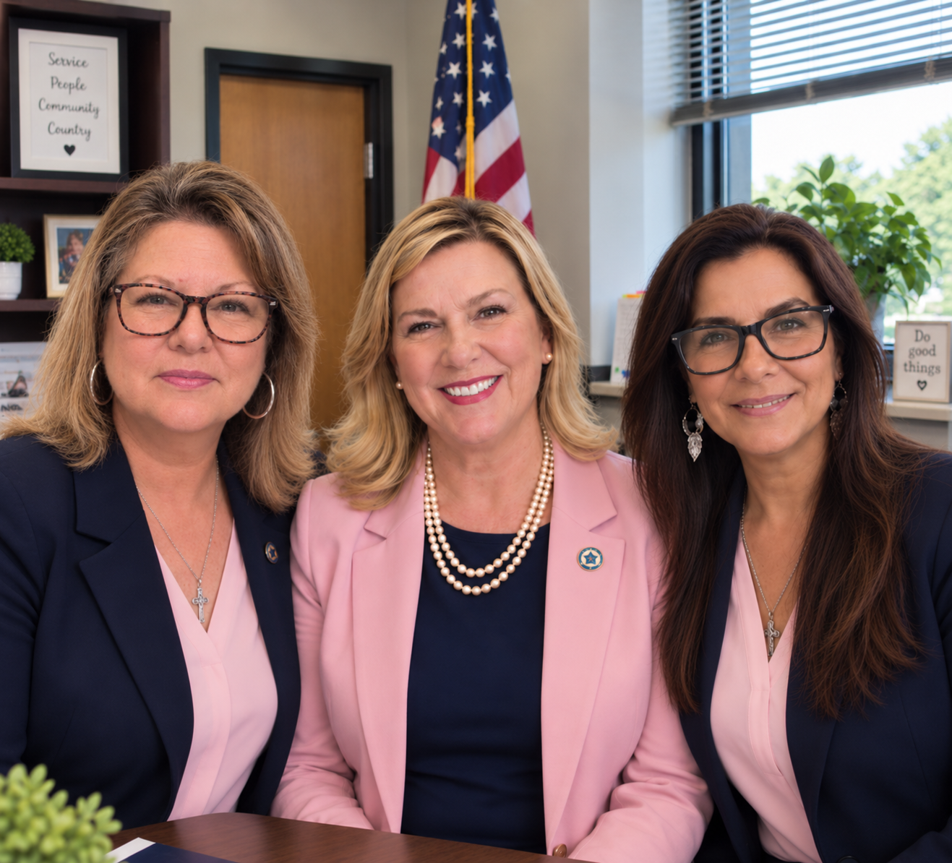
Connecting Florida Units who want to Make an Impact.
Penny Kanbara ❤️ 3rd Vice President, Department of Florida – C&Y Chairman
Tricia Winegar 🤍 JHACH Department Representative
Cherry Jaramillo 💙 JHACH Champion
Notes:
Hello, everyone! I’m Tricia Winegar, and it’s truly a pleasure to be with you today. Thanks so much for joining us.
You’ll see three of us here: Penny Kanbara, our Department 3rd Vice President and Children & Youth Chairman; me, your Johns Hopkins All Children’s Department Representative; and Cherry Jaramillo, our JHACH Champion.
Together, we help connect our Auxiliary members with Johns Hopkins All Children’s and our four Ronald McDonald Houses here in Tampa Bay.
Our role is really about making those connections easier. We help units and districts understand current needs, coordinate and deliver donations, and connect volunteers with opportunities to make a difference.
Our goal is simple: help make it easier for every unit in Florida to make an impact.

Slide 2
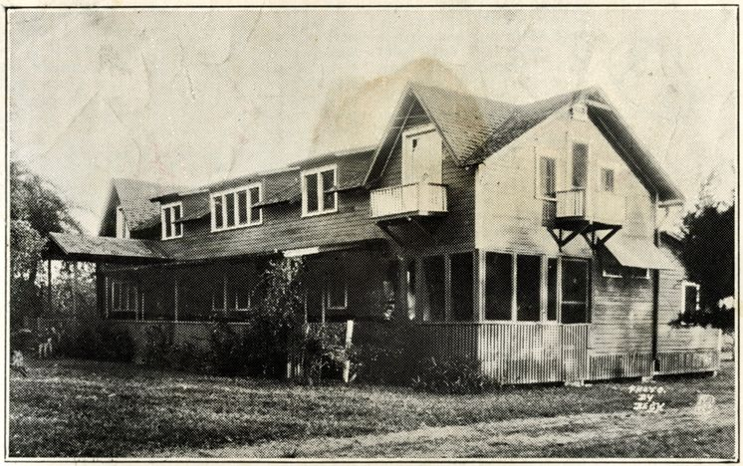
A Century of Caring Together
So, the story goes….
“At the peak of the polio crisis, two Legion members went to Orlando and ‘basically kidnapped two or three crippled kids’…”
Originally named:
The American Legion Hospital for crippled Children
— Tampa Bay Times, 2019
They saw children who needed help — and they acted...
the need is still here.
American Legion Auxiliary • Johns Hopkins All Children’s Hospital
Notes:
In 1926 the American Legion Post 14 established a crippled children's hospital at 22nd Avenue South. in St Petersburg. The two-story structure on three and one-half acres The original building had been a private residence, then it was a prohibition-era night spot called the "Green Cabin" (which was said to be owned by Johnny Torrio, a top henchman of gangster Al Capone), and then a citrus packing plant. Was originally named The American Legion Hospital for crippled children.

Slide 3
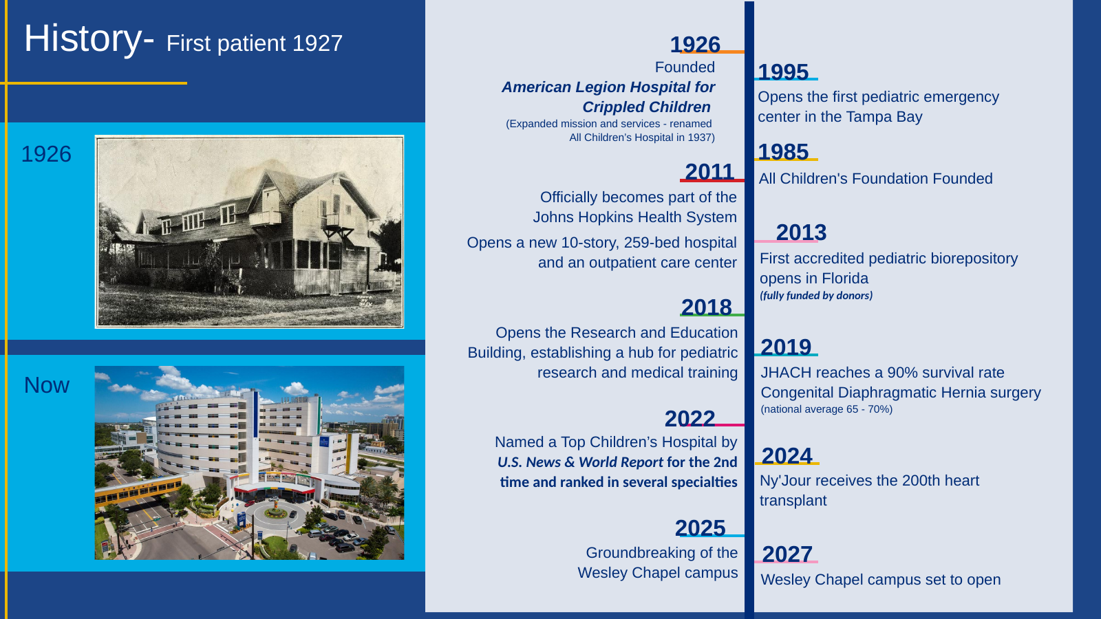
Notes:
.

Slide 4
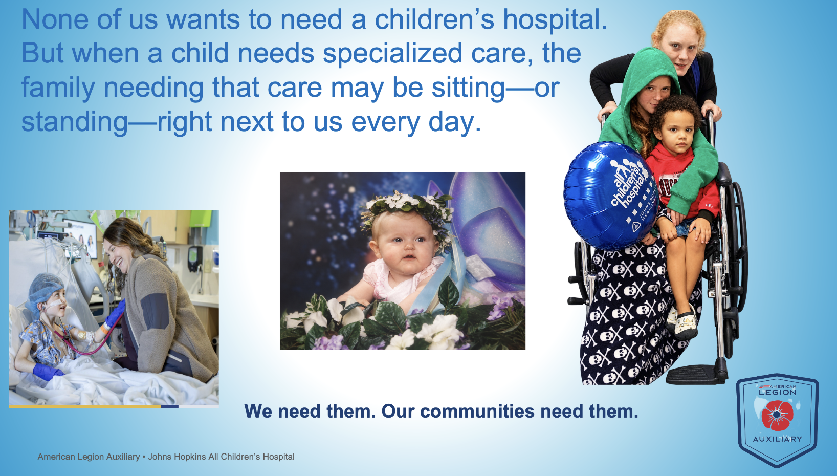
Notes:
This story is personal. When a child receives care at All Children’s, it touches more than one patient—it touches an entire family.
These pictures tell that story in different ways. Among those pictured are my granddaughter, Brianna York, and Monica, Amber, and Emmanuel Grant of the Hoyland family. And I bet many of you could add a picture of your own.
Every day, there are little—and sometimes very big—miracles happening within the walls of this hospital. Behind those miracles are extraordinary doctors, nurses, specialists, and staff who understand that exceptional care isn’t only about the child—it’s about caring for the family that loves that child, too.
Their families could be our families—and very often, they are

Slide 5


Slide 6


Growth is a response to real families who need care.
West Expansion — St. Petersburg
New Wesley Chapel Campus
• New interventional radiology suite
• Three additional operating rooms
• MRI unit and blood bank
• Enhanced Emergency Center support
94%
of children in the Wesley Chapel region currently leave the area for pediatric specialty care.
Bringing specialized pediatric care closer to families.
Groundbreaking: March 27, 2025 • Proposed opening: 2027
St. Petersburg is expanding. Wesley Chapel is growing. Families need this care.
American Legion Auxiliary • Johns Hopkins All Children’s Hospital
Notes:
The groundbreaking took place in 1926, and in 1927, the first child was cared for at the hospital our American Legion Auxiliary helped establish.
And here’s a beautiful connection—Its my personal belief that God has a way of lining things up. Their new Wesley Chapel facility is expected to welcome its first child in the fall of 2027—exactly 100 years after that first child was cared for in 1927.One hundred years of care—and a new chapter beginning. Theres an expansion in St Petersburg

Slide 7

The Impact of Giving
IMPACT OF DONOR SUPPORT
What donor support makes possible
$14.45 MILLION
Total Raised
5,798
$2.18M
$3.65M
donors
raised through
events
through Children’s Miracle
Network partners
700
73
patients comforted through the
Facility Dog Program
patients enrolled in philanthropically
funded cancer & blood disorder trials
Hough Institute for Brain Protection Sciences
June 2023
Every gift becomes part of a child’s care.
❤️ 🤍 💙
American Legion Auxiliary • Johns Hopkins All Children’s Hospital
Notes:
Every gift becomes a part of a child's care

Slide 8
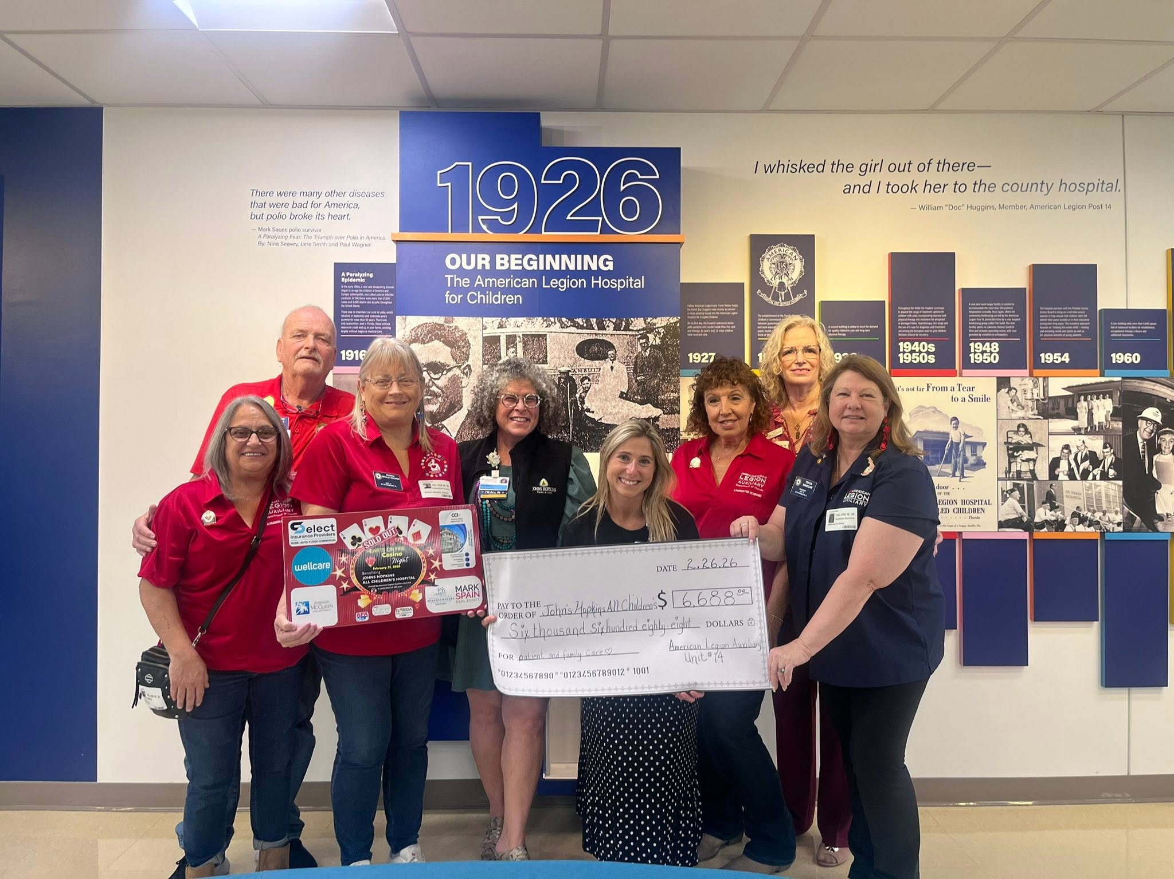
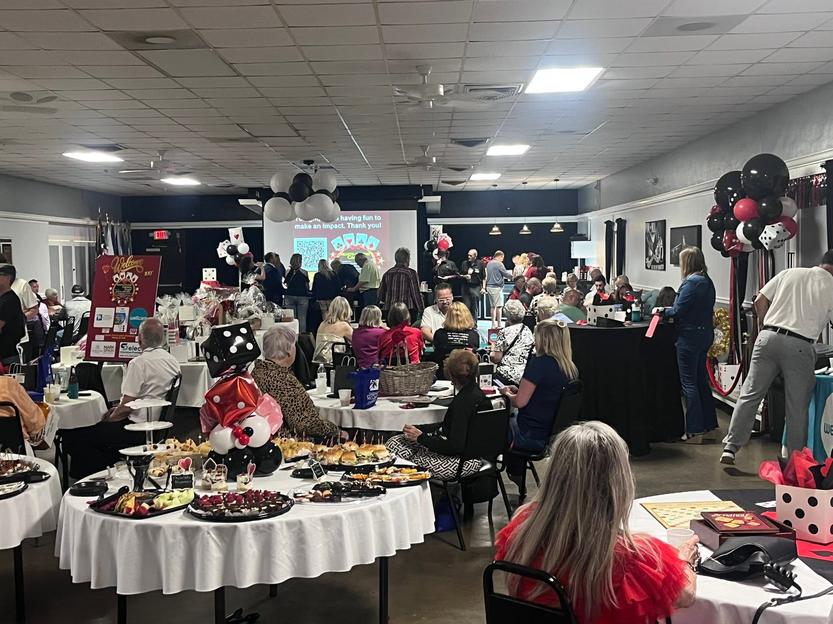
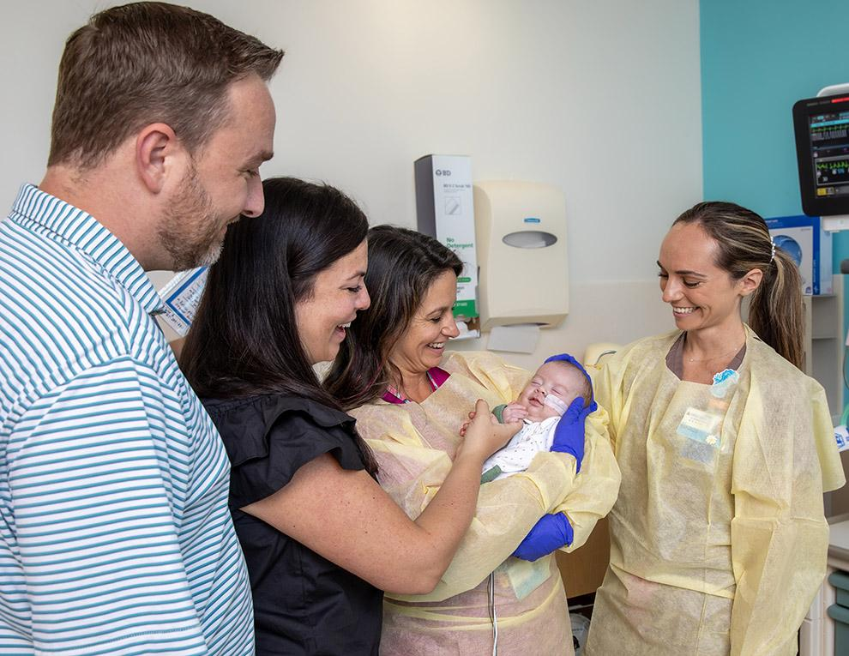
Where the Auxiliary Can Make a Difference
Philanthropy helps turn excellent care into even greater possibilities.
CARE
INNOVATION
ACCESS
Support programs and family-centered needs that reimbursement may not fully cover.
Help advance research, technology and treatments for children.
Help bring specialized pediatric care closer to more families.
There are many ways to help—and every Unit can find a way that fits.
American Legion Auxiliary • Johns Hopkins All Children’s Hospital
Notes:
And I want you to remember this: never underestimate what one Unit can do. Unit 14—the founding Unit in this story—raised nearly $7,000 for Johns Hopkins All Children’s Hospital last year and inspired others to give with their casino night. That’s 5 committee members, one team, finding a way to make a difference.

Slide 9
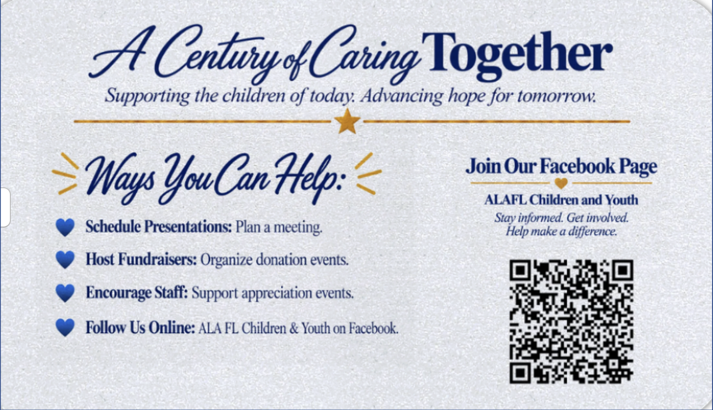
❤️🤍💙
Shenanigans With a Purpose!
Notes:
Shenanignas with a purpose
Schedule presentations, via zoom or in person. Host a fundraiser, encourage the staff of the hospital AND keep up with whats happening. Maybe your unit cant do somethng but there might be another unit that is doing a fundraiser and your unit wants to help. Or even you, your business, your friends or you personally. Just follow the C&Y FAcebook page to keep up with all C&Y shenanigans including those from ACH and RMDH

Slide 10






Choose Your Shenanigans!
Your Unit.
Your Talents.
Your Community.
Your Fundraiser.
Notes:
Your fundraiser doesn’t have to look like anyone elses—whatever works for your members and your community. The idea is simply to find your way to do it 4 Kids.
Because when our Units each do their little bit, those little bits can become something pretty extraordinary for the children and families who need us
Rack ’Em 4 Kids — pool tournament
Strike ’Em 4 Kids — bowling
Puttin’ 4 Kids — golf or miniature golf
Bakin’ 4 Kids — bake sale, dessert auction, cookie walk
Walkin’ 4 Kids — community walk or pledge walk
Cruisin’ 4 Kids — car show, Jeep event, motorcycle ride
Fishin’ 4 Kids — fishing tournament
Tossin’ 4 Kids — cornhole tournament
Singin’ 4 Kids — karaoke night
Jammin’ 4 Kids — live music fundraiser
Thinkin’ 4 Kids — trivia night
Dealin’ 4 Kids — card night or casino-style fundraiser
Cookin’ 4 Kids — chili cook-off, BBQ competition, tasting event
Craftin’ 4 Kids — craft fair or make-and-take event
Shoppin’ 4 Kids — vendor fair/holiday market
Dancin’ 4 Kids — dance, sock hop or themed party
Paws 4 Kids — pet walk, pet photo day or pet-themed fundraiser
Decoratin’ 4 Kids — holiday tree/wreath auction
Growin’ 4 Kids — plant sale or garden fundraiser
Playin’ 4 Kids — family game night, bingo-style games, board-game tournament

Slide 11
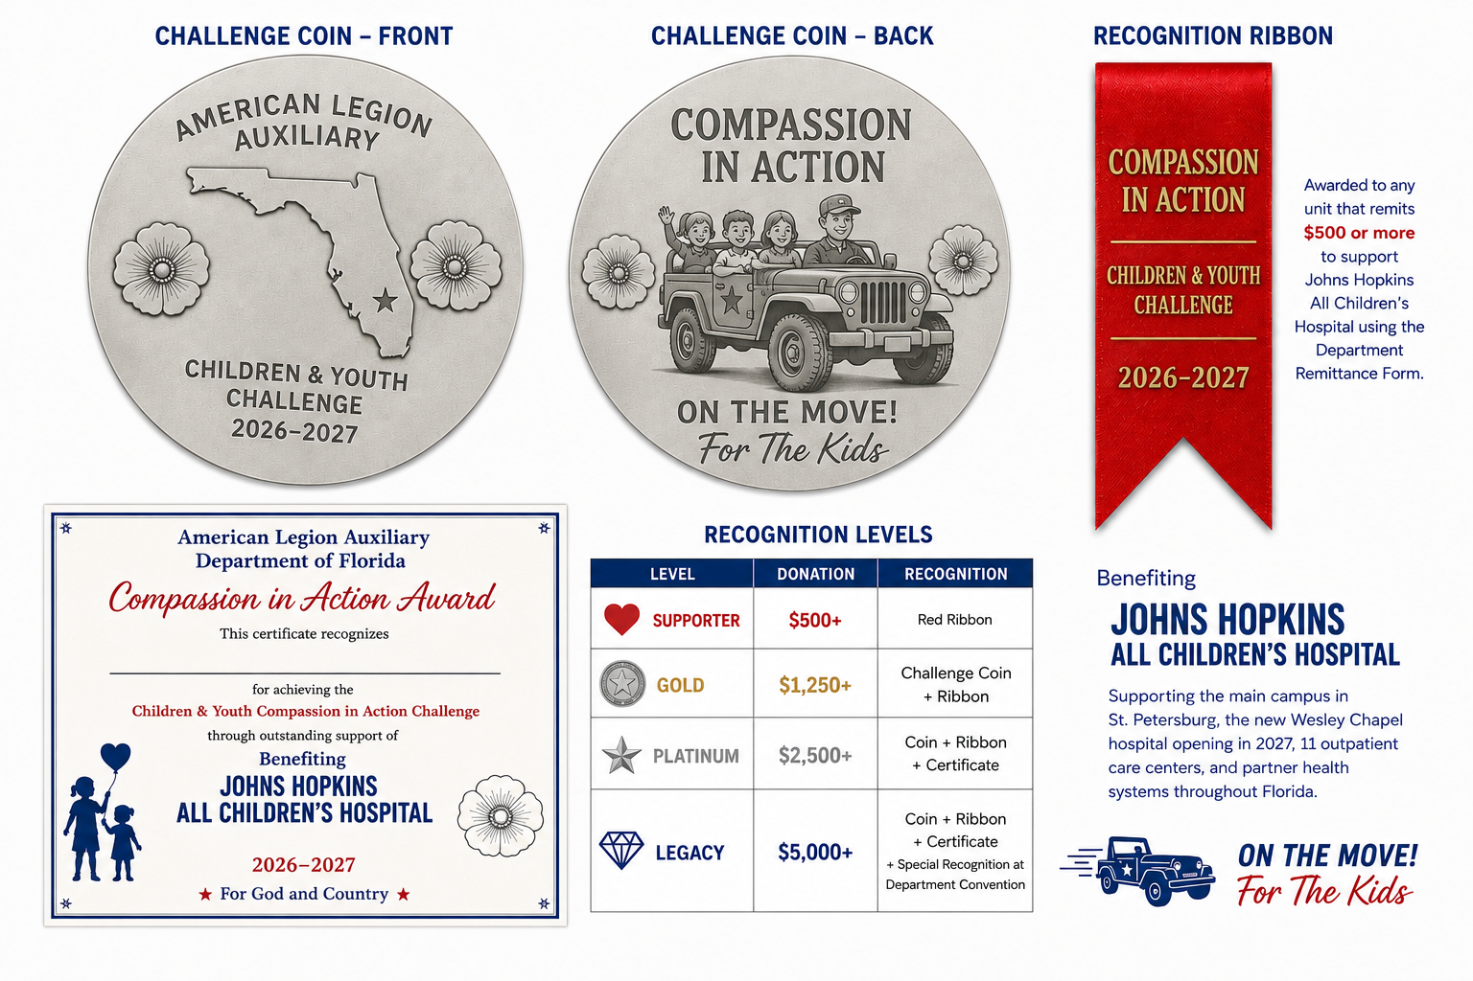
Compassion in Action
Recognition for Units that choose to support the 2026–2027 effort.
****WORKING TOWARDS A WAY TO RECOGNIZE ALL UNITS THAT GIVE TO JHACH. NOT JUST THE ONES THAT GO THROUGH DEPARTMENT REMITTANCE
Choose what fits your Unit. Every act of compassion matters.
American Legion Auxiliary • Johns Hopkins All Children’s Hospital
Notes:
So to inspire you a bit, This is our Compassion in Action Challenge, There are three recognition levels for a ribbon, a coin an award, and a shoutout at department convention.......and I want to emphasize one thing—this is not a competition between Units. The only Unit we want you competing with is your own! Look at what you did last year and ask, What could we do this year?.. We want you to choose what fits your Unit and have a little fun challenging yourselves.
We’re also working to make this recognition available whether your donation goes through Department or directly to Johns Hopkins All Children’s. When you connect with our team, we can help explain how to document your giving. We are still developing some of those details—including what documentation will be accepted and whether in-kind donations will be included—so please be patient with Penny, Cherry, and me as we pilot this new program with the hospital, Department, and our Units.
And please remember, the criteria for this challenge are separate from other Department award requirements. This is something new, and we want to build it thoughtfully and fairly.
Most importantly, this isn’t really about the coin, the ribbon, or who gives the most. It’s about the kids. But we also believe your energy, generosity, and intentional giving deserve to be recognized—because when volunteers know their efforts matter, it inspires them to keep serving, keep dreaming, and keep finding new ways to help.
And your recognition can do something else—it can inspire another Unit. When we share what you’ve accomplished and the creative ways you made it happen, another Unit might look at your idea and say, “Hey, we could do something like that!” Your success this year might just spark someone else’s shenanigans next year—and that means even more good being done for kids.

Slide 12

Notes:
but wait! Theres more! Here’s an additional challenge for you! Your Unit can participate in our Compassion in Action Challenge, the Ronald McDonald House Challenge—or both!
Our primary Ronald McDonald House connection is with the four Houses that serve Johns Hopkins All Children’s, but we can also help Units connect with Ronald McDonald House programs throughout Florida. If you’re closer to Orlando, Fort Myers, Miami, Pensacola, Gainesville, Jacksonville, or Tallahassee, reach out to me and we’ll help make that connection.
For this challenge, any Unit that gives $250 or more will receive one Ronald McDonald House recognition pin for the Unit. Just like our other challenge, this isn’t about competing with another Unit. It’s another way to challenge yourselves, support children and families, and have your generosity recognized.

Slide 13
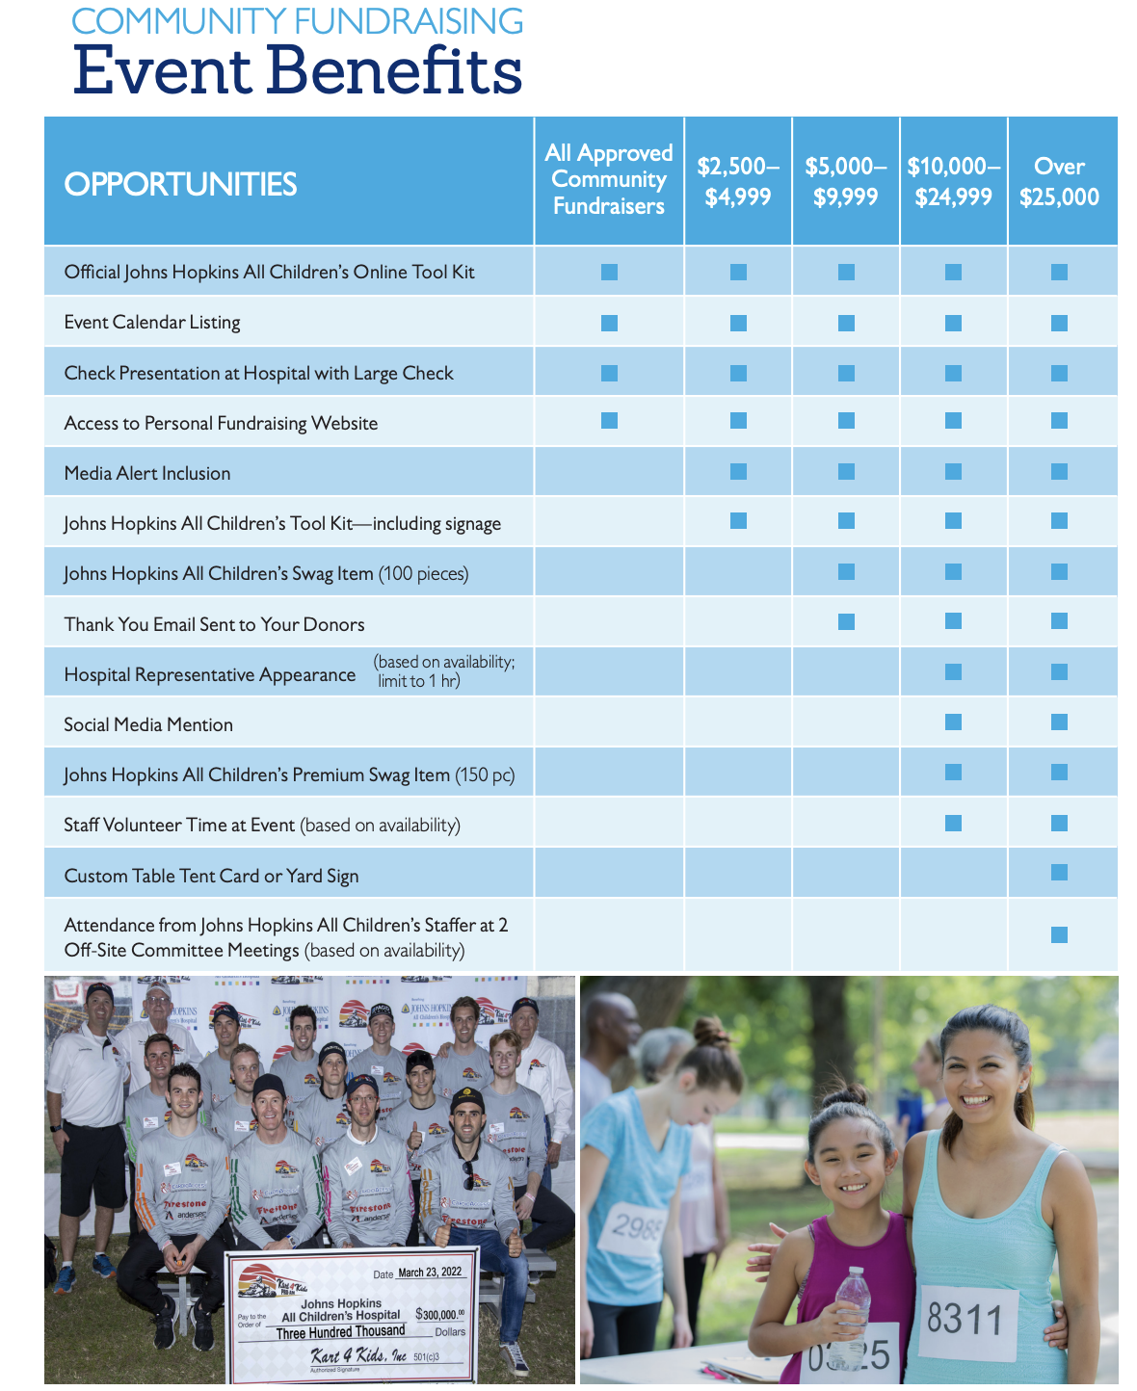
From bake sales to major events—every dollar matters.
If you’d like JHACH resources, recognition, or participation, connect with us early.
Notes:
Every fundraiser doesn’t have to be big. A bake sale, a collection, or a little shenanigan 4 Kids matters—because every dollar counts.
But many Units may not realize that Johns Hopkins All Children’s wants to partner with us on our fundraising initiatives. If you’re thinking bigger—even if it’s for next year—come talk to me early. They have resources, opportunities, and a Community Fundraising Packet that can help us build successful events together.
And when possible, using the Department donation remittance process helps JHACH see our collective impact. We aren’t individual Units giving in isolation—we are one statewide Auxiliary working together.
There’s something pretty special about that partnership. Our Auxiliary helped them get started nearly a century ago, and today they want to help us continue doing good for their kids.

Slide 14
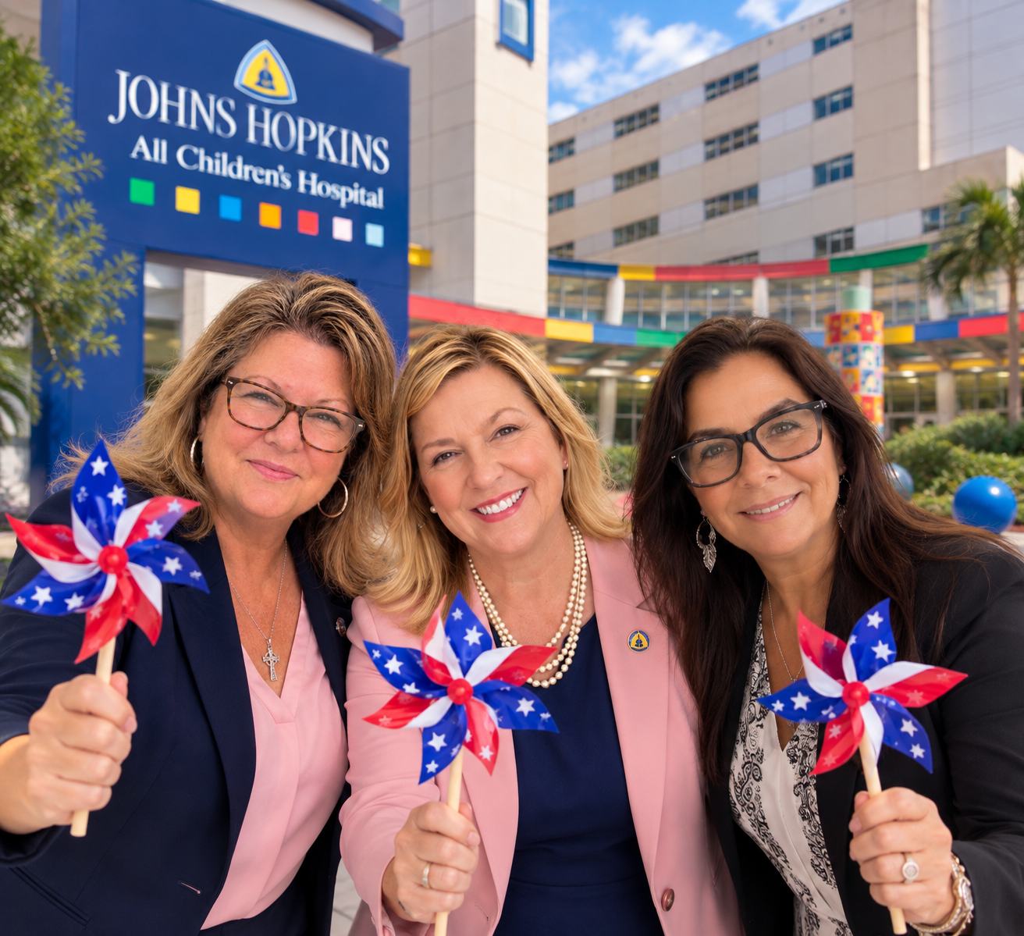


The full story can be brought to your Unit or District
• In person
• On Zoom
• At a time that works for you
LET’S CONNECT
They needed us then. We need them today.
Together, we care for the children who need us tomorrow.
Notes:
There Is So Much More to This Story…
Today was just a few minutes, and there is so much more we would love to share. Let’s connect, and we’ll find a way to bring the rest of the story to your Unit—in person or on Zoom.
Don’t compare your Unit to anyone else. Start where you are. Build on what you’ve done. Choose what fits your Unit. And invite us into the conversation.
For anything involving Johns Hopkins All Children’s or Ronald McDonald House, start with me. Cherry, our JHACH Champion, works closely alongside me to help turn your ideas into action.
And because Penny leads all things Children & Youth for the Department, Cherry and I keep her connected to what you’re planning. That helps us coordinate across the state, avoid overlapping efforts or dates, and make sure your ideas work alongside other Unit and JHACH activities already underway.
So bring us your questions, your ideas, and—of course—your shenanigans. We’ll help connect the pieces, \
Let’s keep Doing It 4 Kids.
At the end of the day, every act of compassion matters. Recognition is wonderful, but the real reward is what happens when all those individual acts of love come together for our kids.

Slide 15

Notes:
My name is Tricia Winegar. We are here to help.

