Slide 1

Department of Florida
Community Service 2026-2027
Workshop Presentation

Slide 2
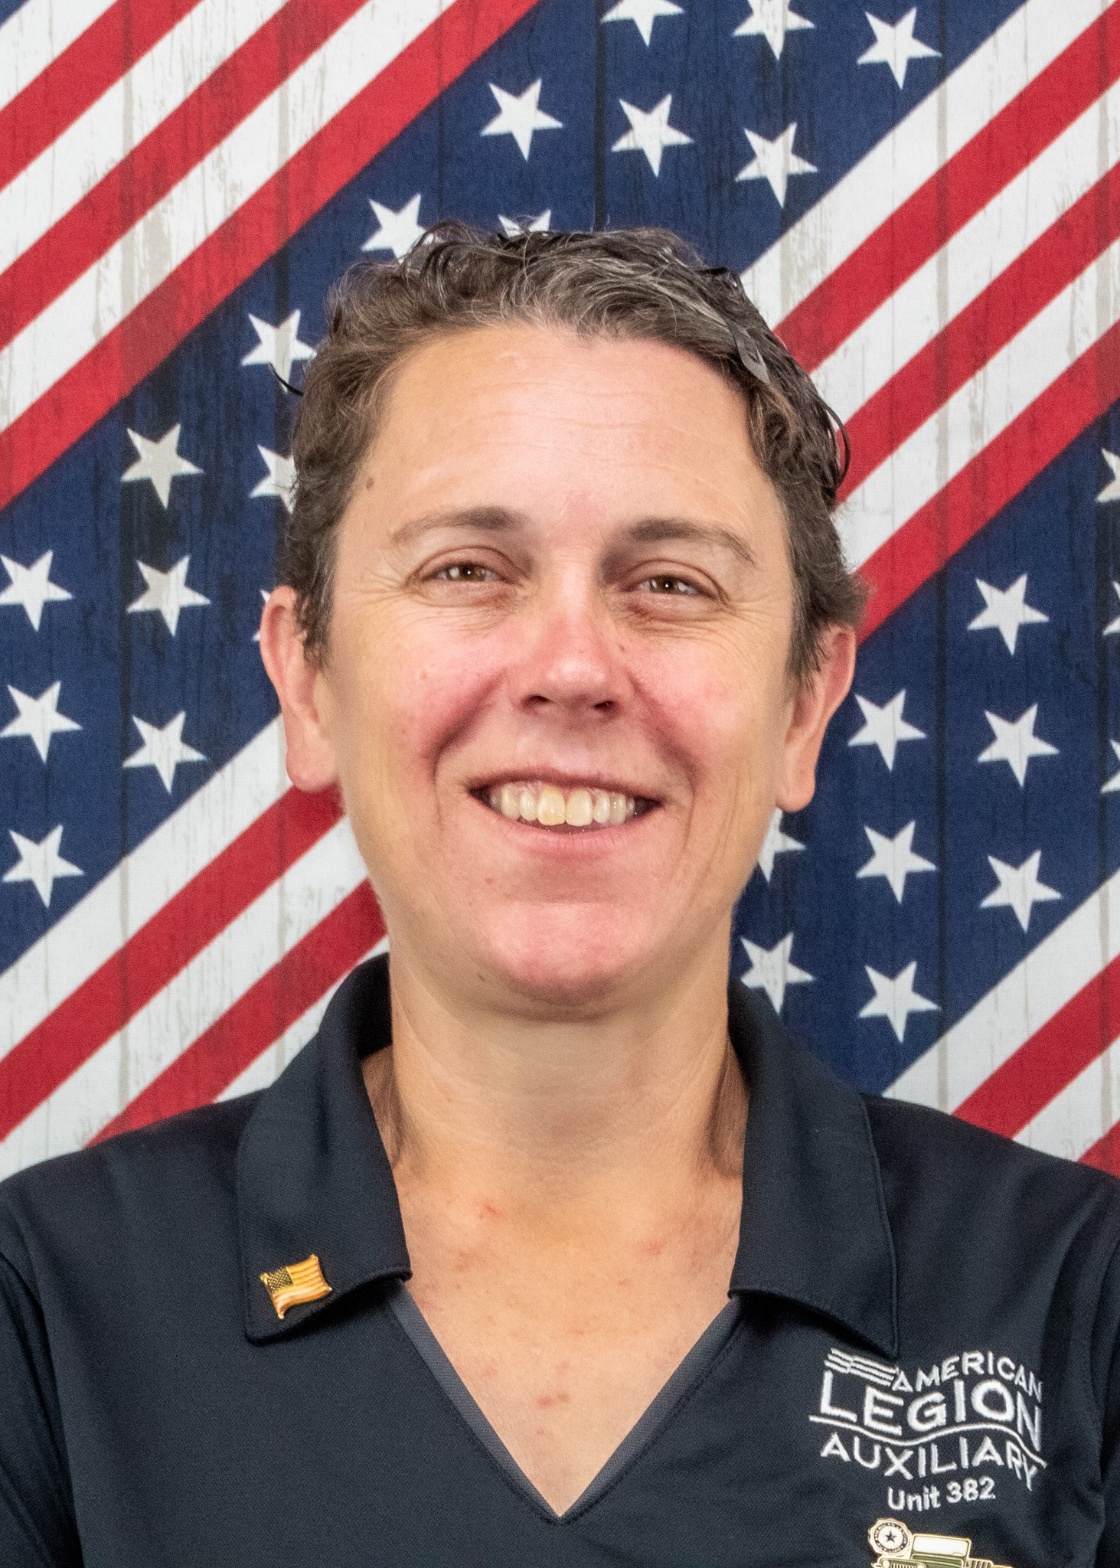
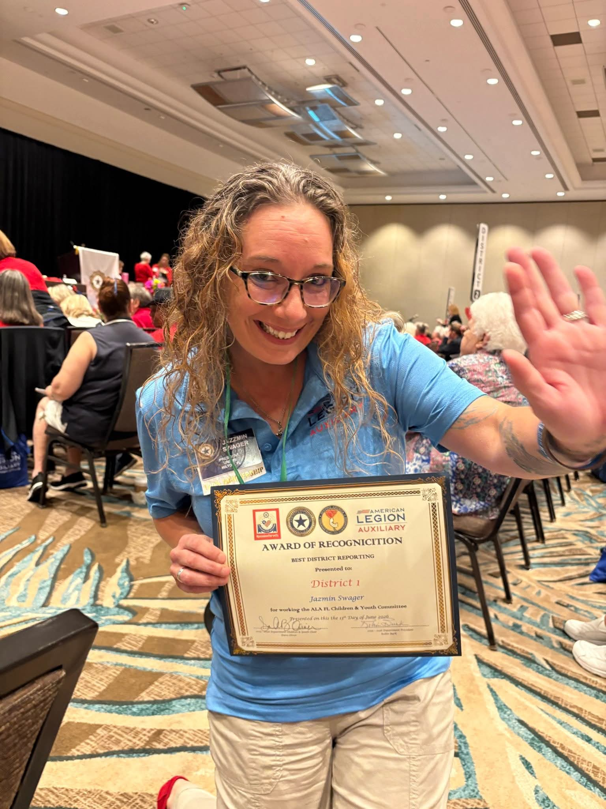
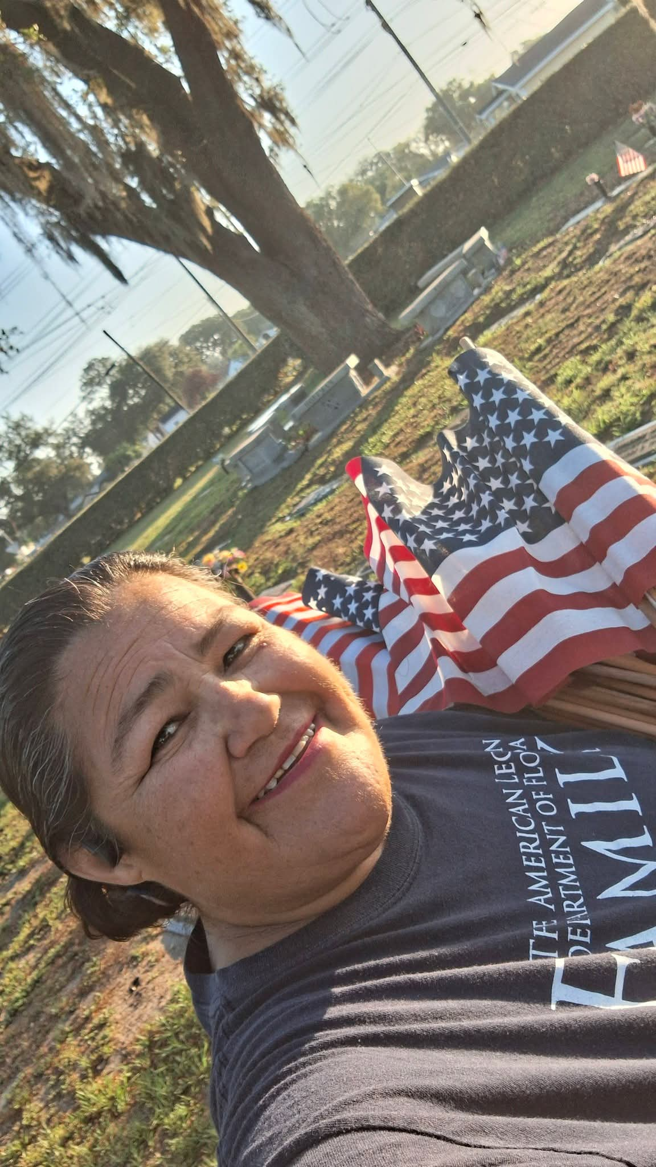
Meet the Team
Alysia Lombard
Dept. Chairperson
Unit 382
Jazzmin Swager
Committee Member
Unit 78
Maria Rivera
Committee
Member
Unit 72

Slide 3
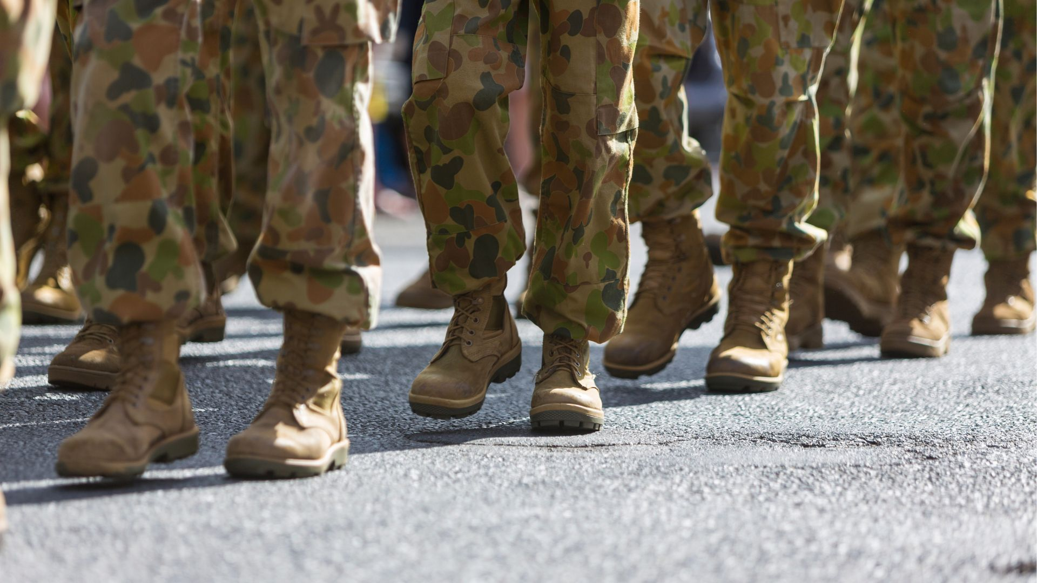
Operation Boots: Marching our mission through our Community….

Slide 4
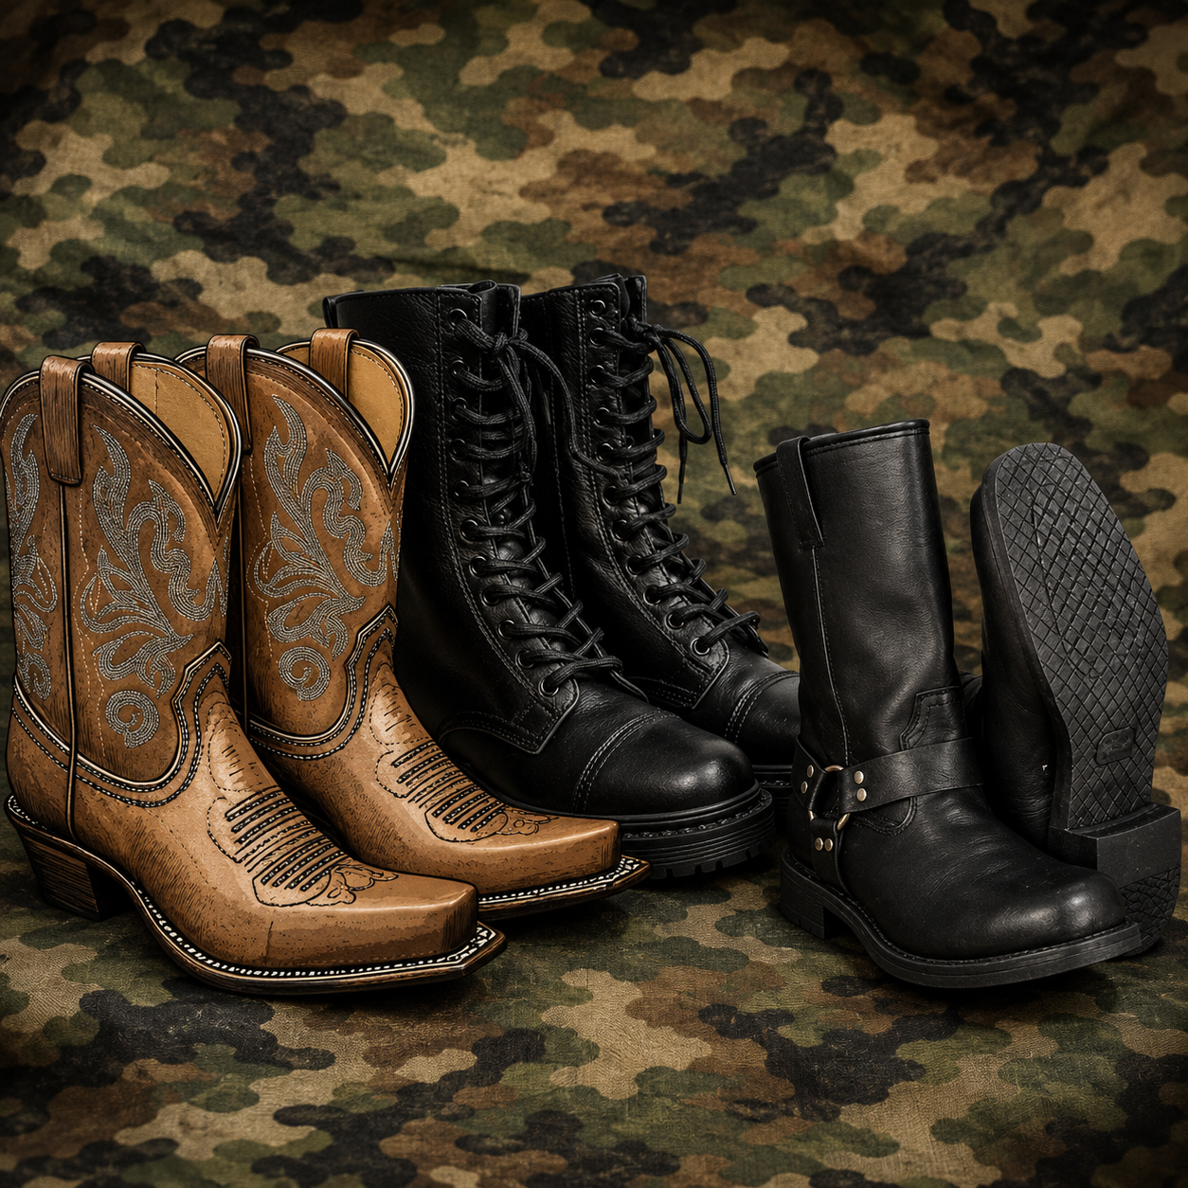
Show off your Boots!

Slide 5

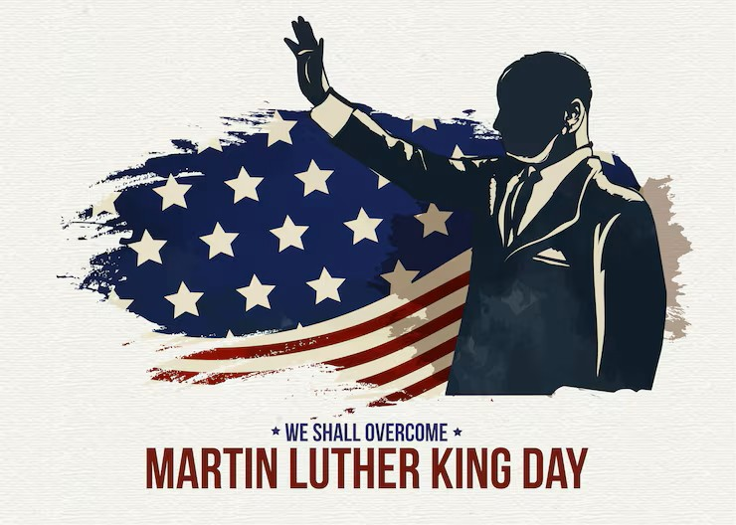

Days of Service
September 11th 2026 – Patriot Day
January 18th 2027 – Martin Luther King Jr Birthday
April 24th 2027 American Legion Family Day

Slide 6
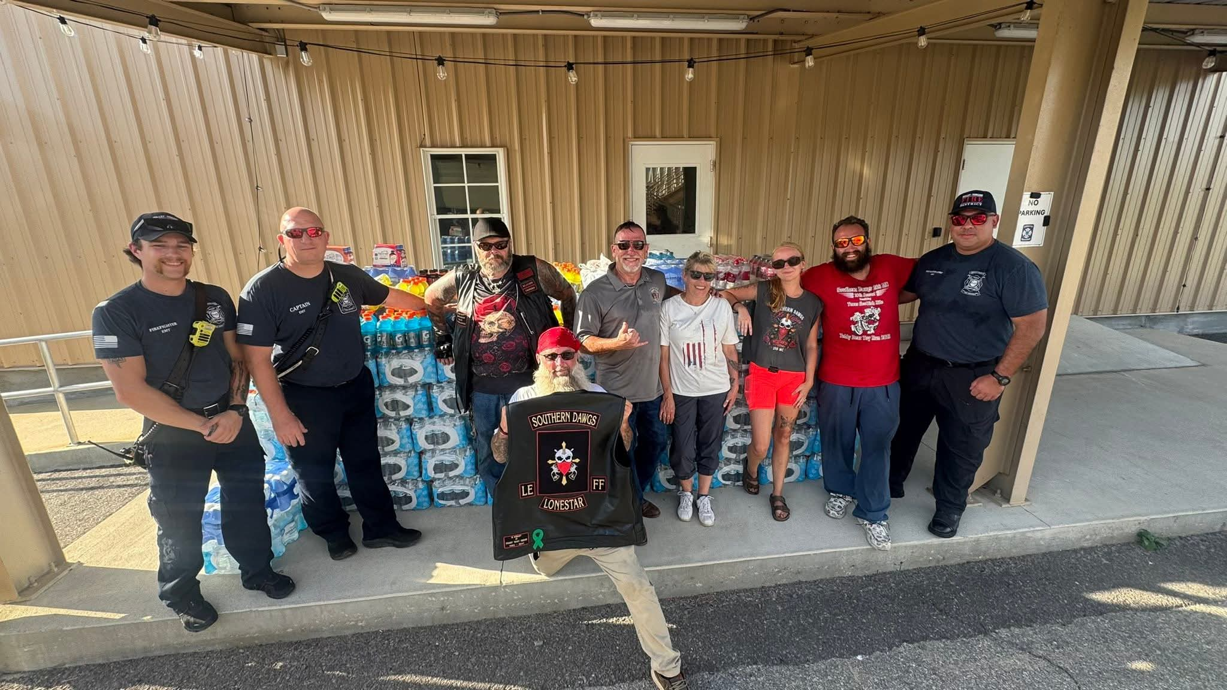
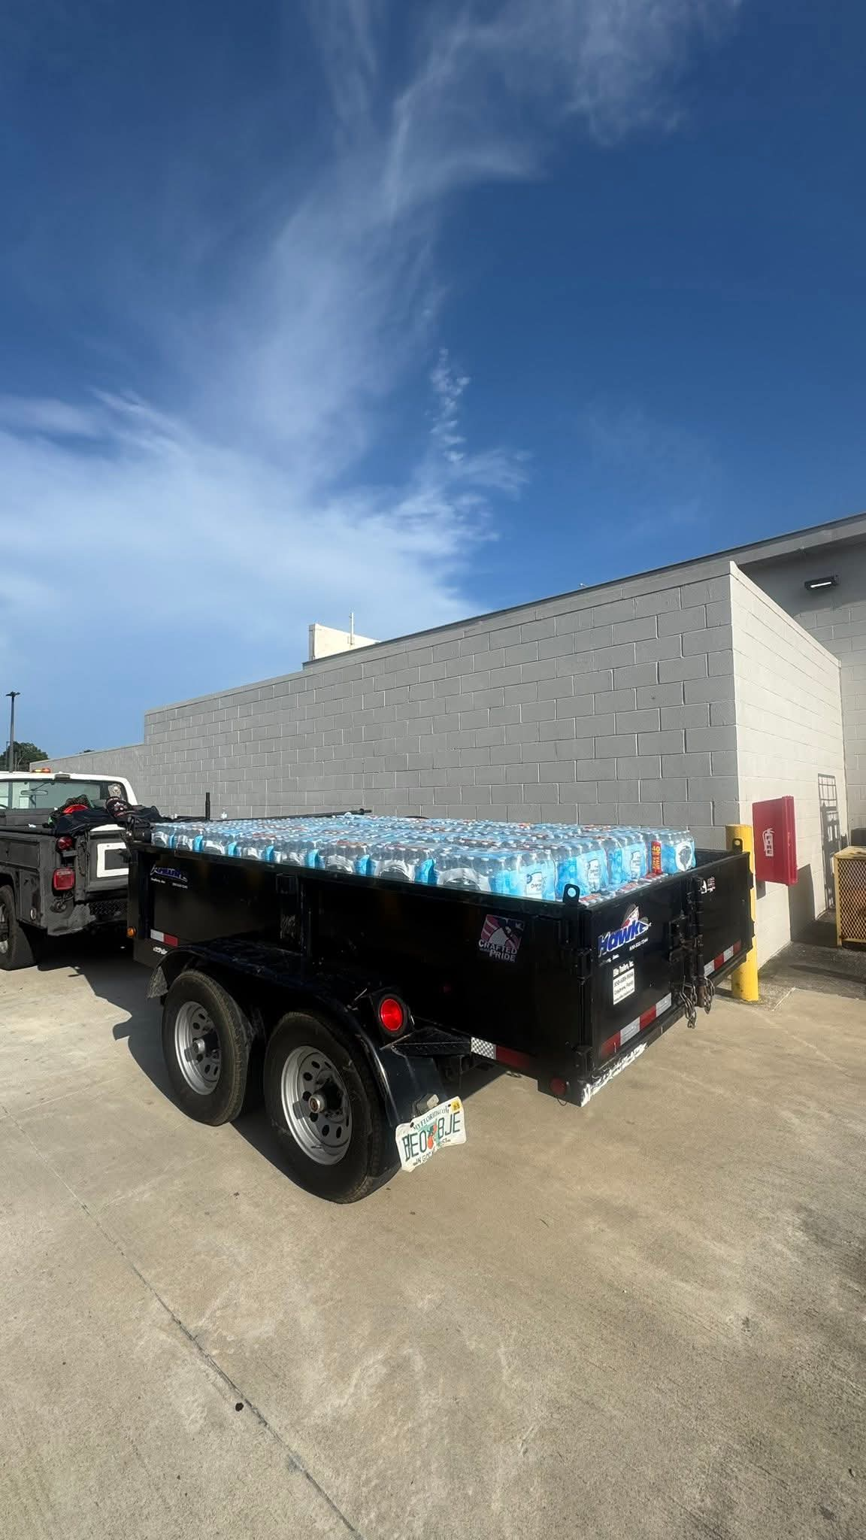
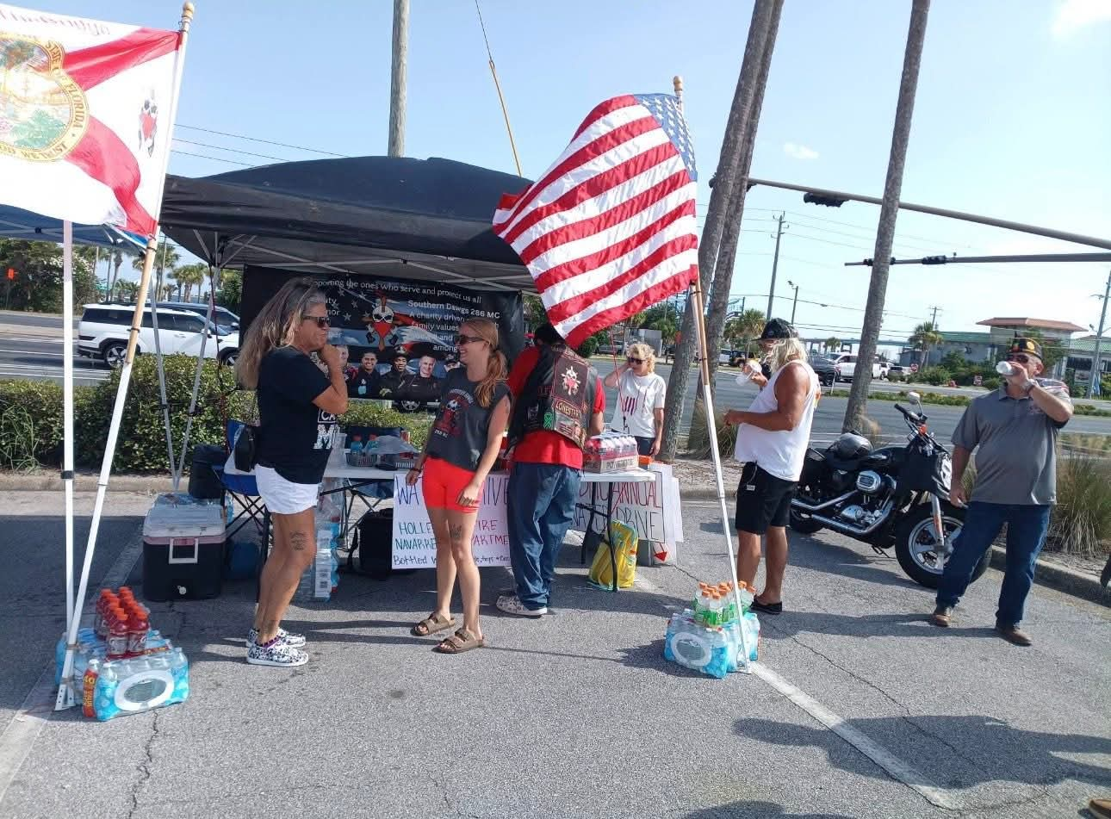
Supporting other Groups who
support your community
Unit 382 Navarre
Supporting
a water drive for
the Fire Dept.

Slide 7






Slide 8
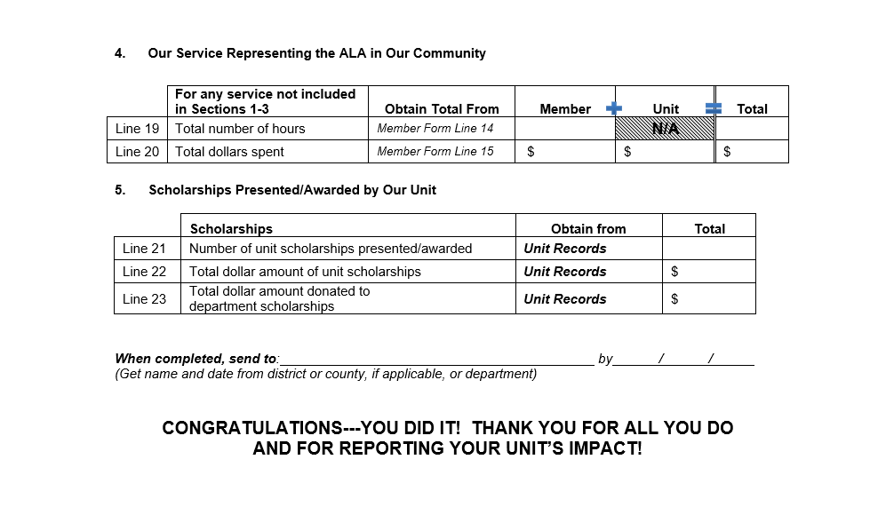
Record your Hours and Dollars!

Slide 9
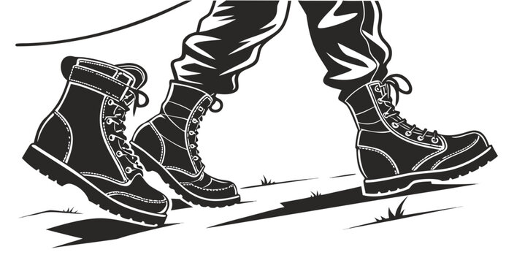
Awards
*
*
Marching Boots
Chairperson Award
*
*
Jan Croft “Hometown Award”
Sponsored by Boynton Beach Unit 164
*
Cathy Larkin-Richards “Back the Badge” Award
Sponsored by Madeira Beach Unit 273
*
Due Date will be May 26th 2027

Slide 10
Support those who support us

