Slide 1





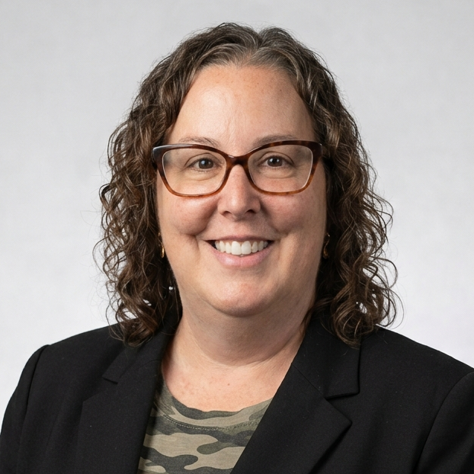
ALA FL HISTORIAN
2026-2027
Julie Kay
historian@alafl.org

Slide 2
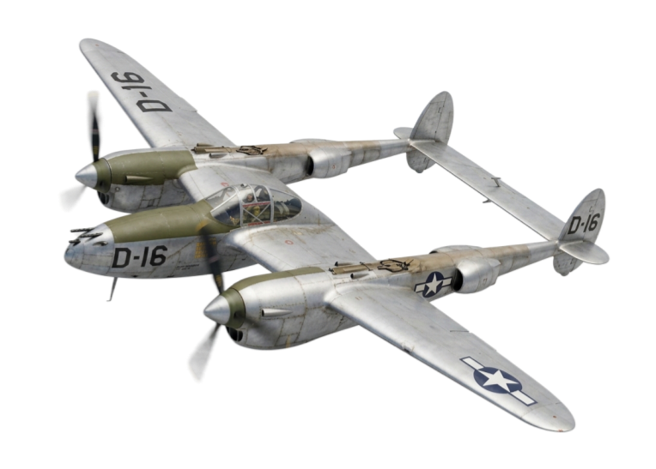




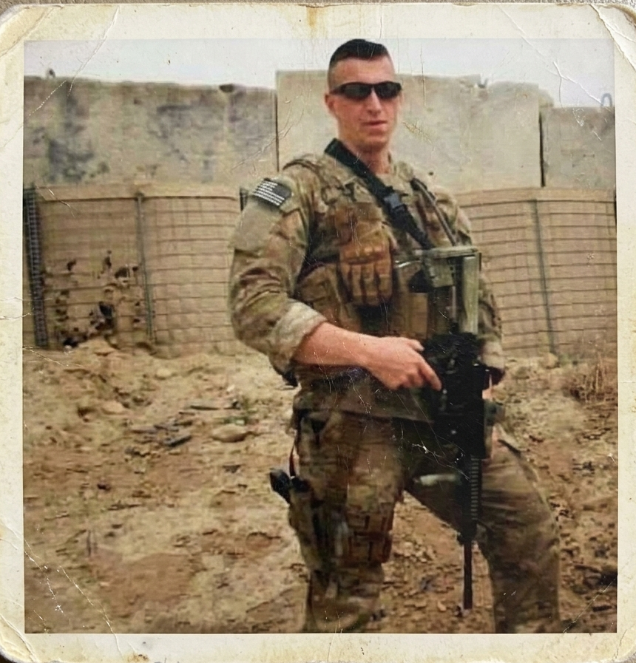
MISSION
AUXILIARY SERVING
HEROES
MEMORIES
ARCHIVED
SHARED
HONORED

Slide 3
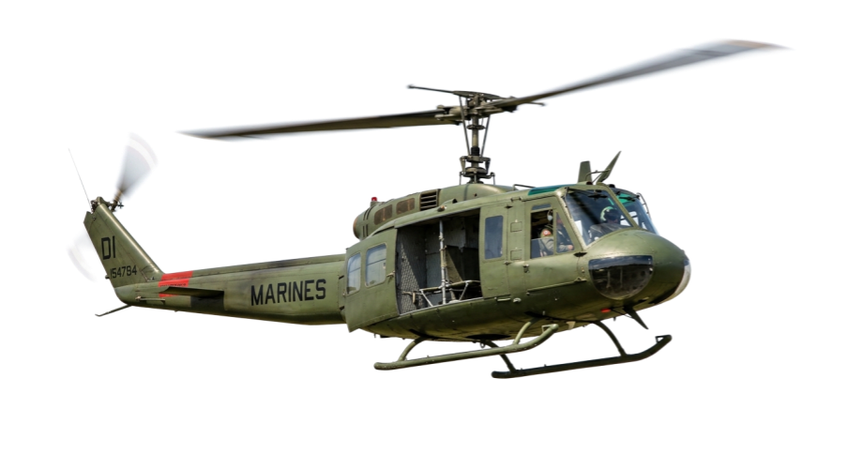
TODAY IS TOMORROW’S HISTORY
  Every meeting you attend…
  Every service project…
  Every membership milestone…
  Every photograph…
  Every newsletter…
  Every veteran interview…
...is another chapter in the history of the American Legion Auxiliary.

Slide 4
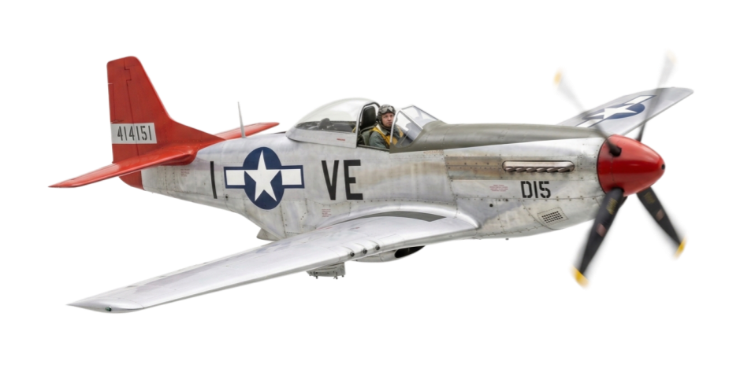
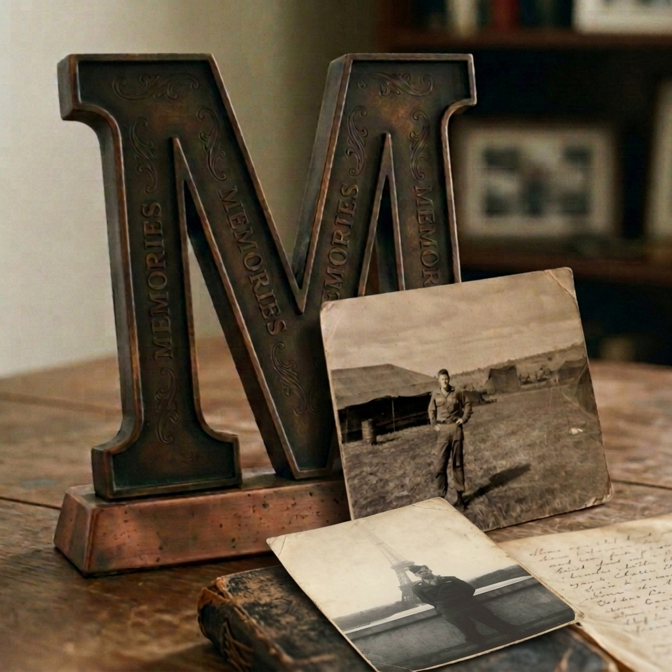
MEMORIES
Monday Member Moments
Document milestones, special events
Collect photographs, articles, stories
Record accomplishments and recognitions

Slide 5
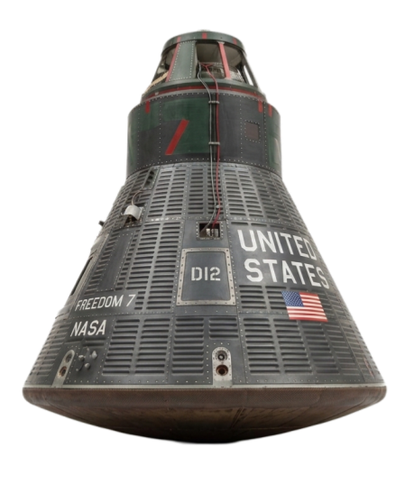

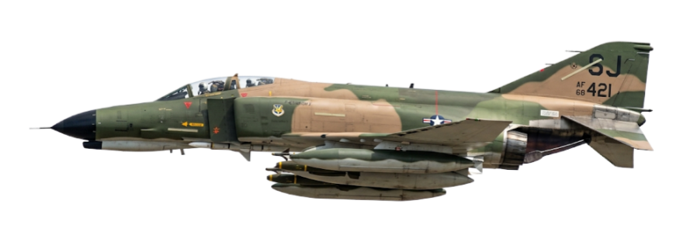
ARCHIVE
Save newsletters, publications, and programs
Maintain digital photo files
Preserve scrapbooks and historical records
Record accomplishments and recognitions
Time Capsule Project

Slide 6
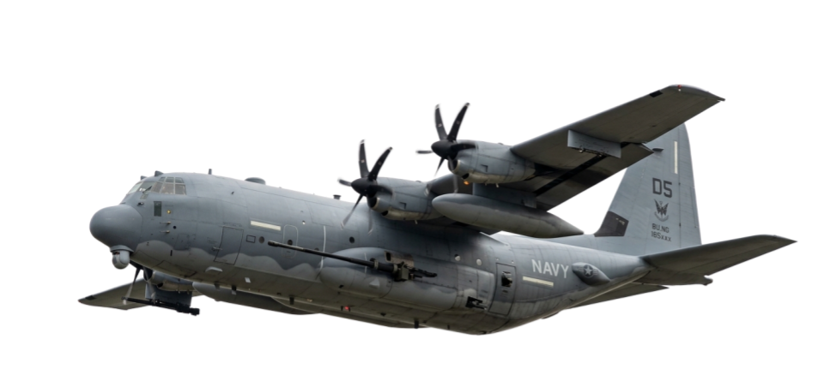
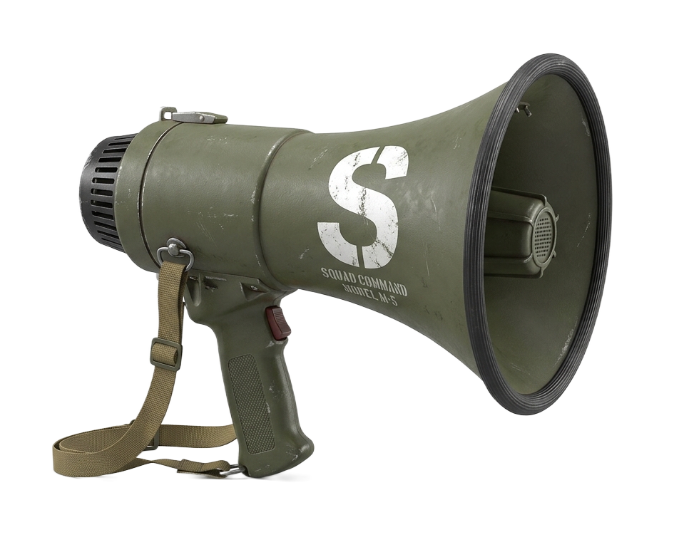
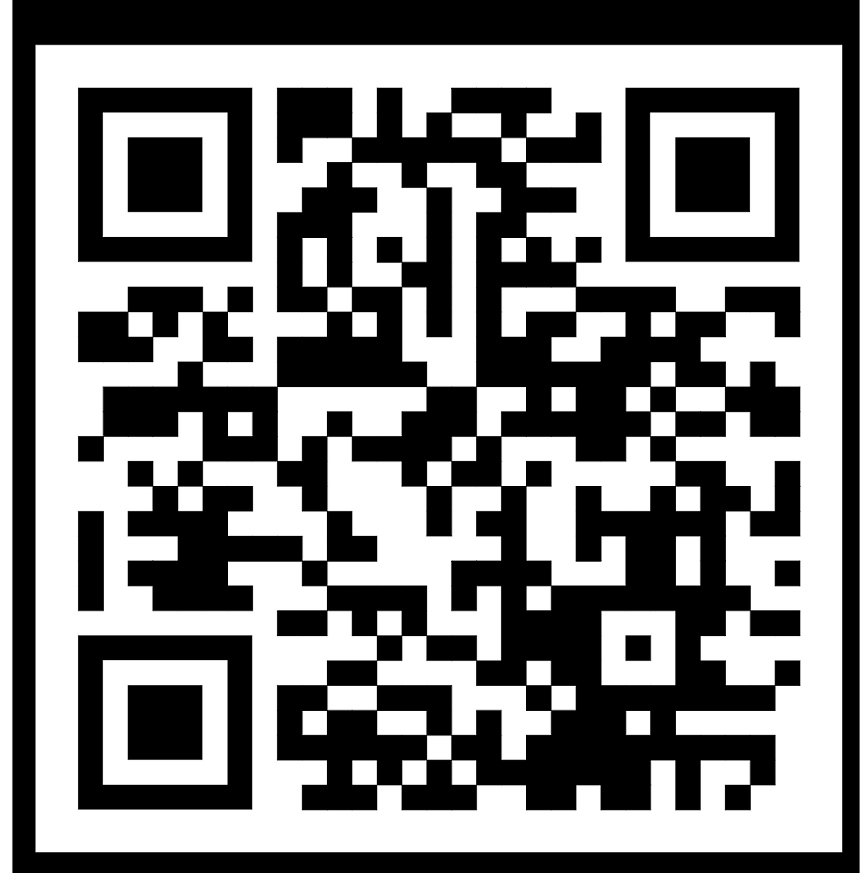
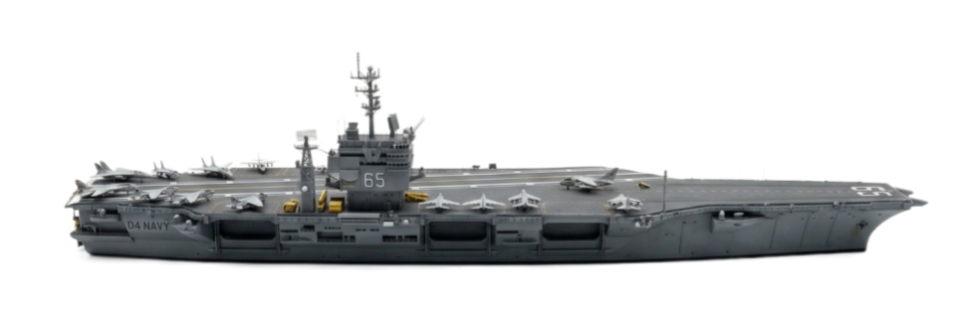
SHARE
Fun Fact Friday
Celebrate Unit Charter Date
Feature historical facts
Women's History Month

Slide 7
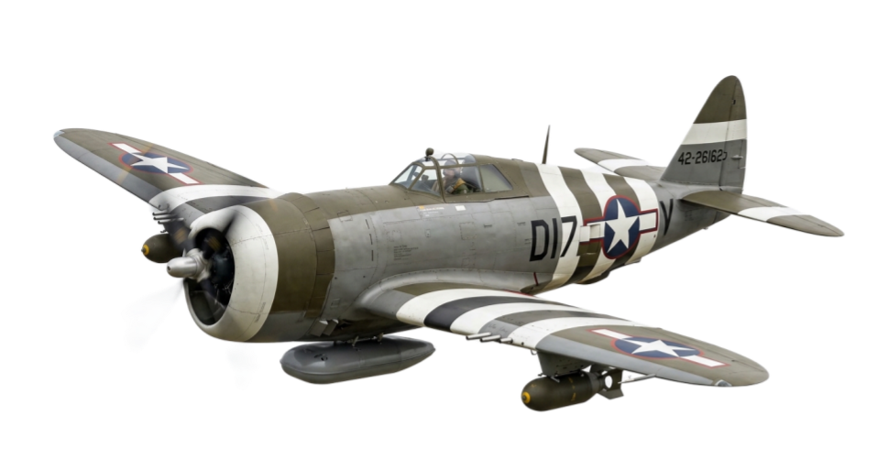
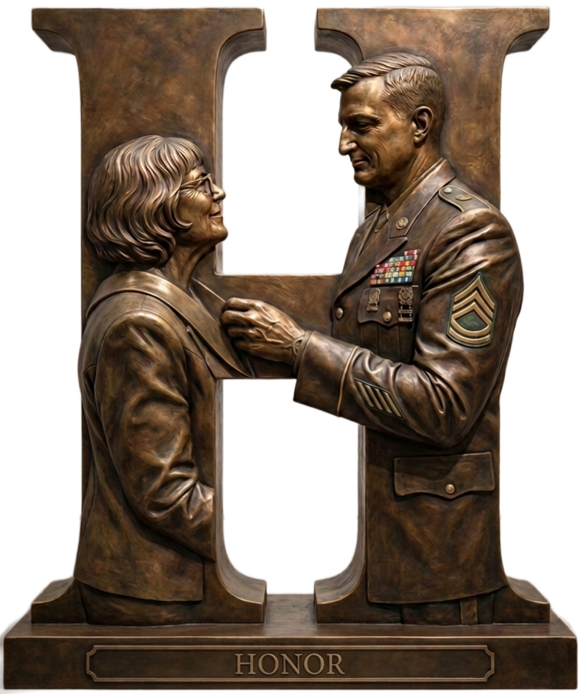
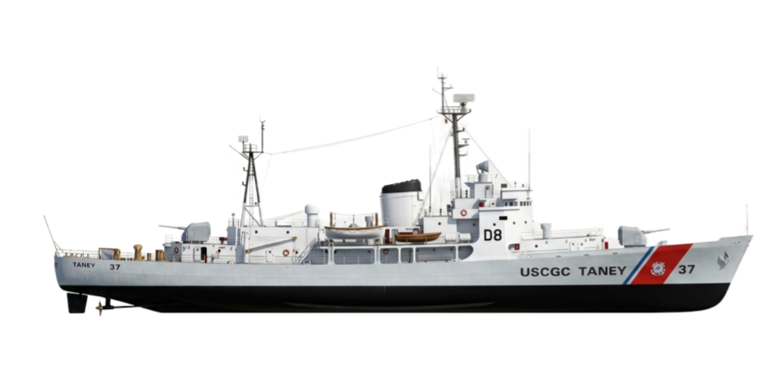
HONOR
Veterans History Project
Members Remember Project
Ensure future generations understand

Slide 8
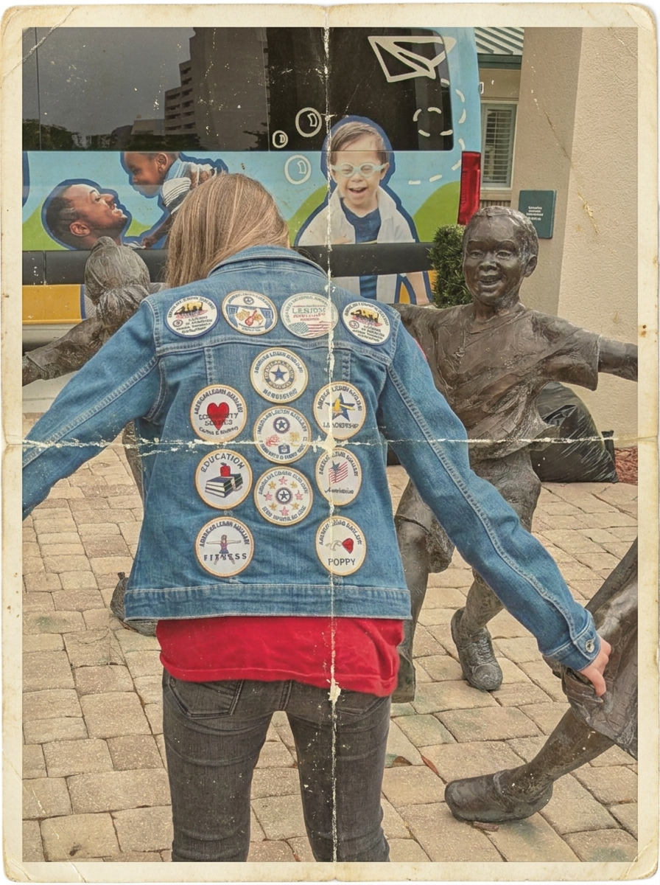
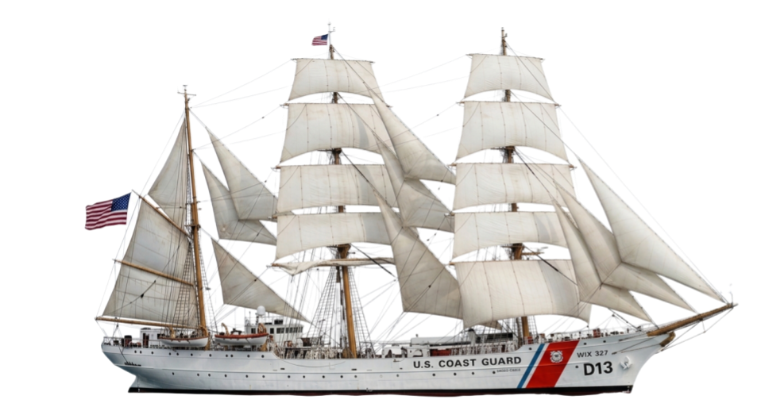

Involve Junior Members
History Patch
Veteran’s History
Member’s Remember
Encourage Participation
Develop the historians of tomorrow!
Notes:
Juniors

Slide 9

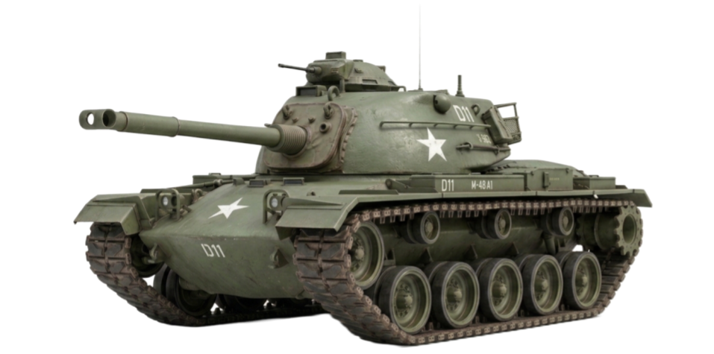
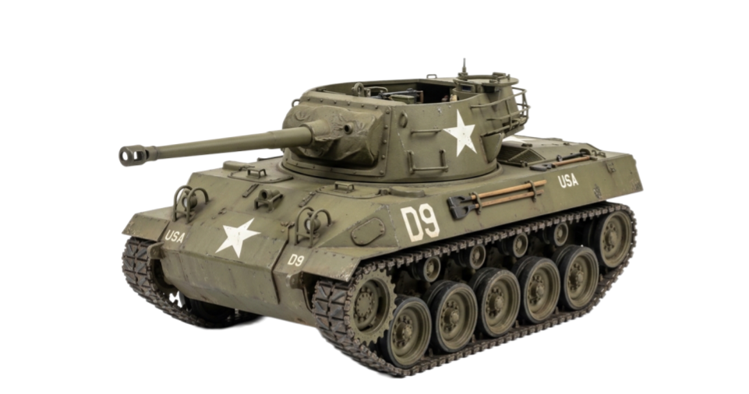
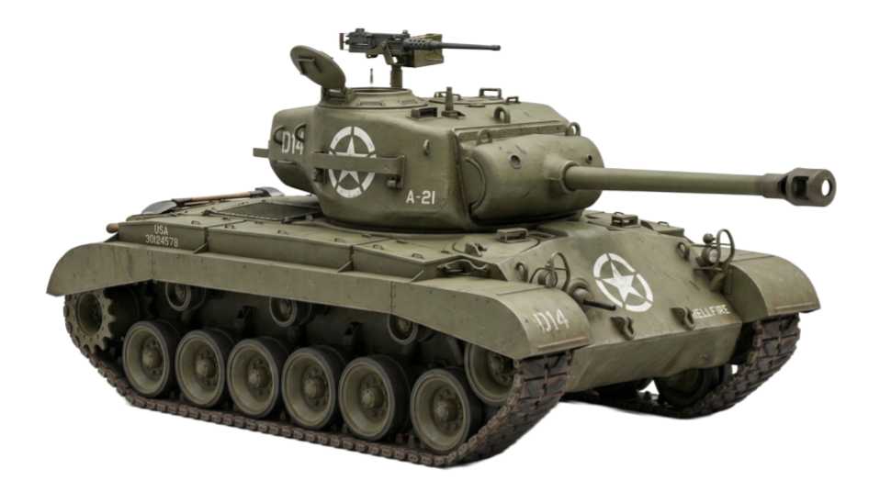
IMPORTANT DATES
Feb 20th
Female Veterans History Project
March
National Women's History Month
April 15
Unit Historian Reports due to District
May 1
District Historian Reports due to Department
June 1
Senior & Junior Department Histories submitted

Slide 10






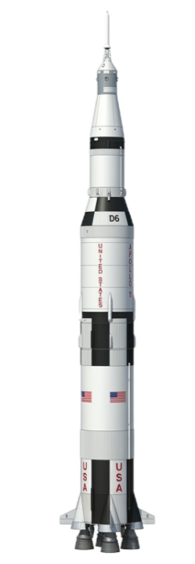






Department Challenge
Every Unit Has a Story
Contribute at least one historical item this year.
Veteran Interview / Member Memory
Historical Photographs
Unit Timeline / Anniversary Celebration
Community Service Project
Preserved Newsletter
One Contribution. One Story.

Slide 11
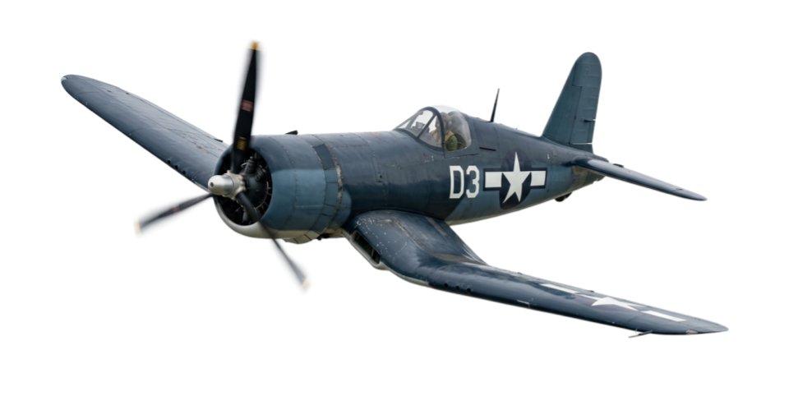

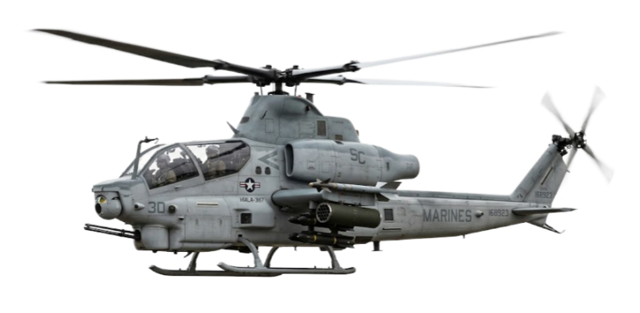
T
O
D
A
Y
I
S
T
O
M
O
R
R
O
W
'
S
H
I
S
T
O
R
Y
Take a picture
Closing Thought
Write a caption
Save the Newsletter
"History is much more than a collection of dates, documents, and photographs. It is the story of service, compassion, patriotism, and dedication."
Put a date on it
Preserve the mission

