Slide 1
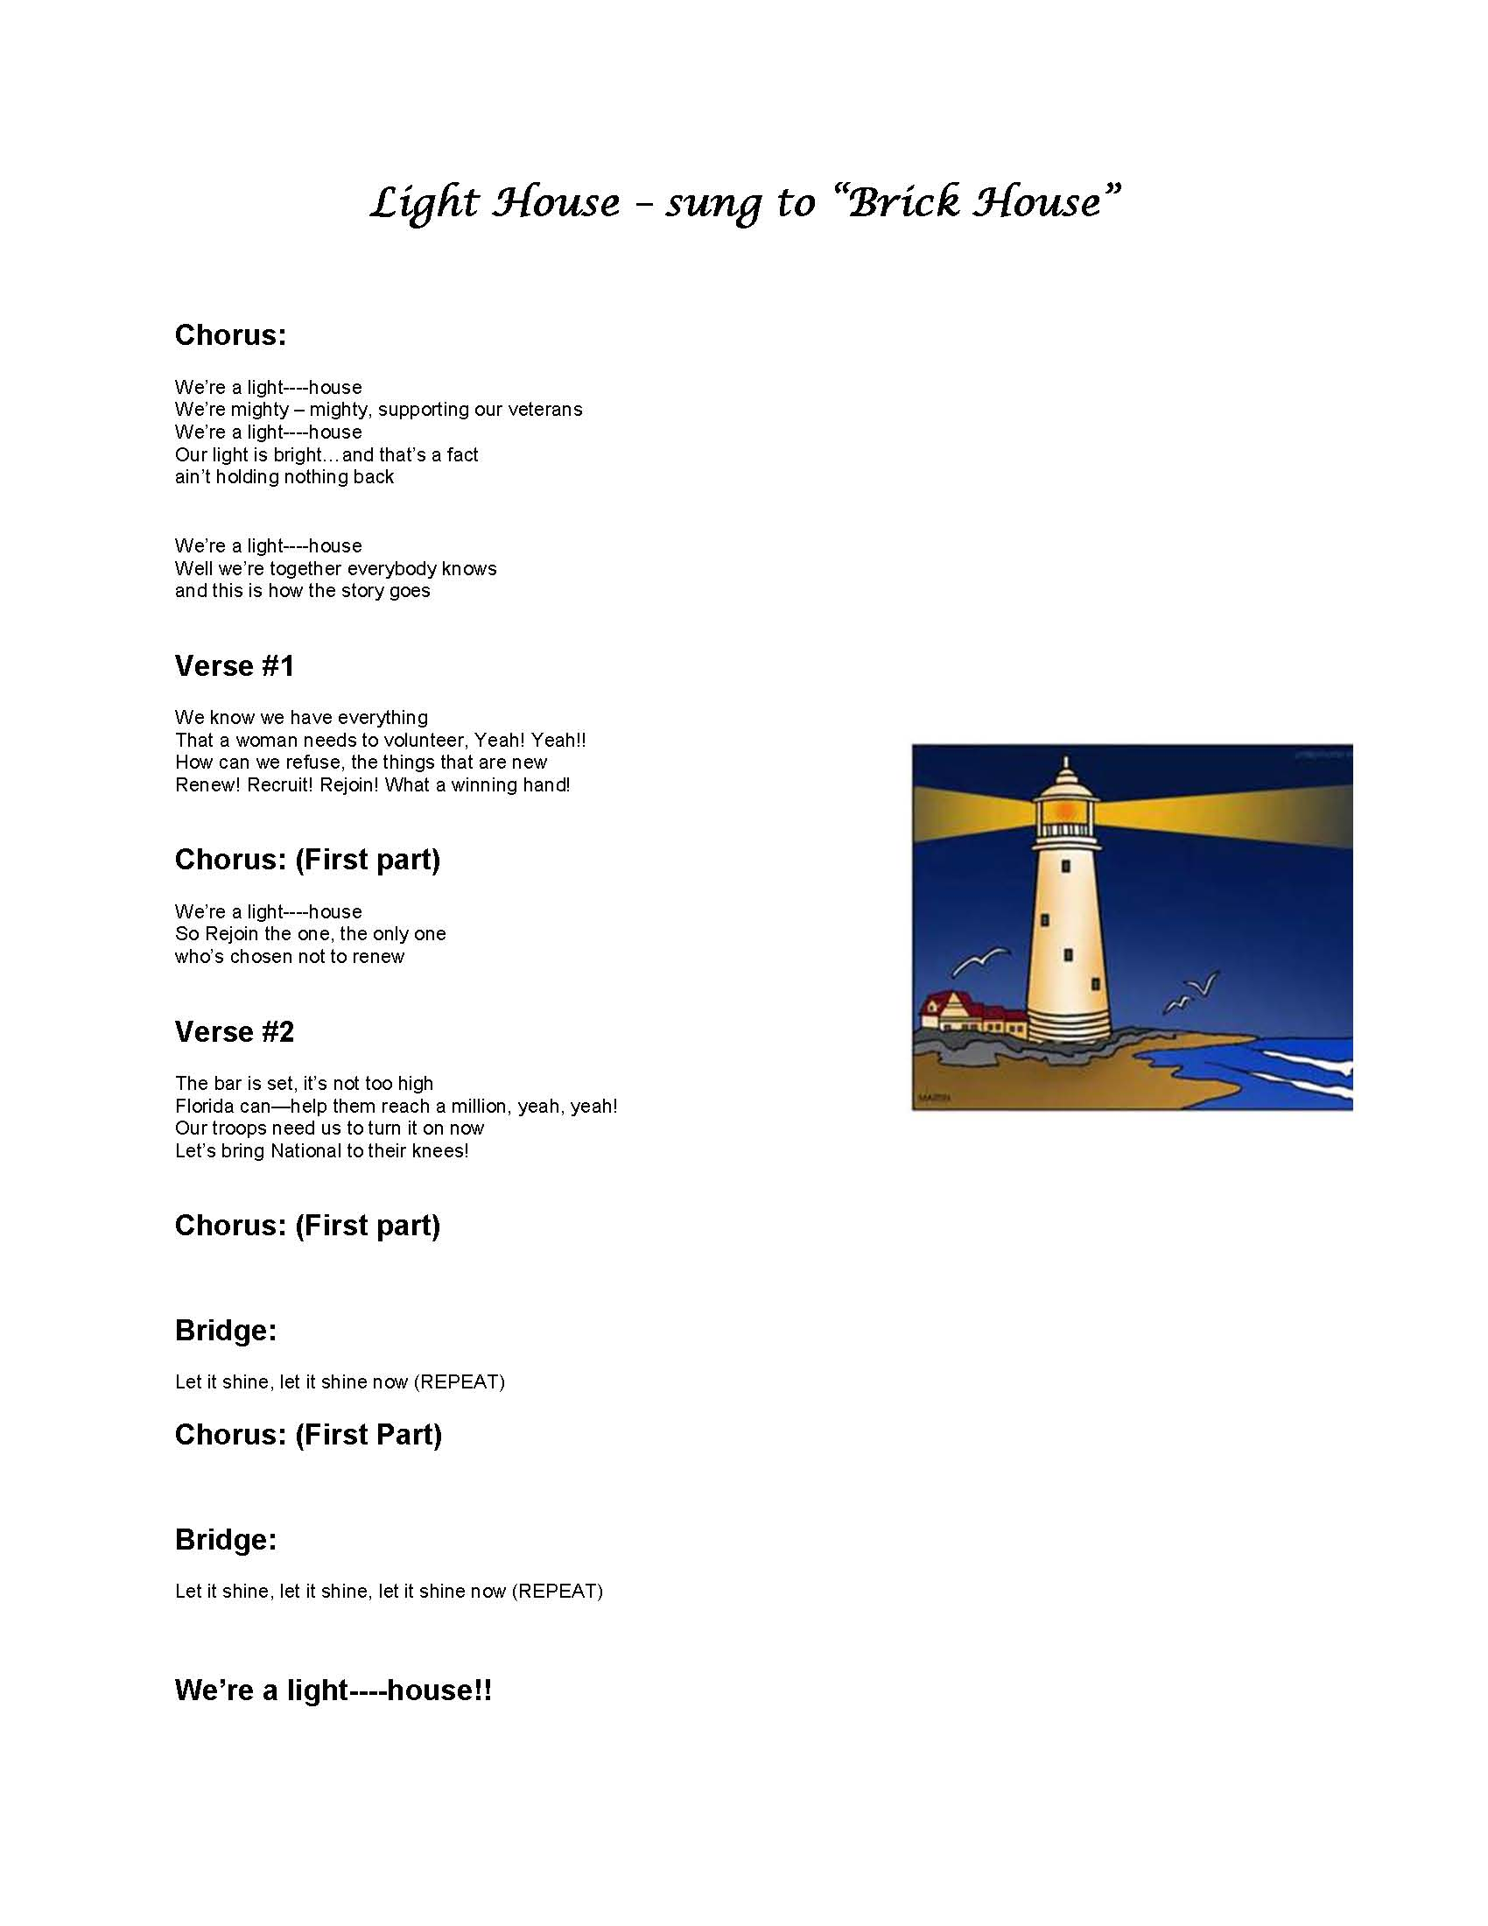

Slide 2
“Shining for Membership”
Jane Hardacre
Membership Chairman
membershipchairman@alafl.org
Committee Members
Western – LaDonna Stovall
Northern – Irma Wehrli
Eastern – Barbara LiButti
Central – Linda Hayes
Southwestern – Linda Hall
Southern – Jo Ann Maitland

Slide 3
2014 – 2015 Membership
National Membership Goal:
By honoring our veterans and military through meaningful service, the American Legion Auxiliary will grow to a million members by their centennial year of 2019

Slide 4
ARE YOU ONE IN A MILLION?

Slide 5
Membership Goal for Florida
2015 Department Numeric Goal: 38,775
2015 Department Monthly Milestone: 3,231

Slide 6
WHAT CAN WE DO?
Engage to Retain Members
Rejoin Former Members
Attract New Members

Slide 7
HOW CAN WE DO THIS?

Slide 8
Engage to Retain Members
Communicate
Be respectful, kind and considerate
Ask for and be open to new and different ideas
Offer volunteer opportunities for members – at times convenient to them
Recognize all members for any contributions
Promptly address and resolve conflicts in a positive manner

Slide 9
Rejoin Former Members
Use ALAMIS to obtain information on members who have not paid dues since 2012
Reach out to these former members
Set up a committee to contact former members
Establish a phone bank of members to call former members
Send a letter requesting feedback with the Unit; determine what the Unit might need to do differently to retain all members

Slide 10
Attract New Members
Increase the Auxiliary’s visibility in the community
Be welcoming, kind and respectful to persons of all ages and backgrounds
Share benefits and value of belonging
Waive first year membership dues for eligible female veterans

Slide 11
Lighthouse Dates
November 4th, 2014 – 60% Renew/Rejoin Achievement
February 7th, 2015 – 85% Renew/Rejoin Achievement
May 28th, 2015 - 100% Total (renew/rejoin and new members)
HIP HIP HOORAY!

Slide 12
Department Awards
Light House Award
Unit President and Membership Chairman with the highest percentage of membership by close of books (one within every grouping)
District President and Membership Chairman with the highest percentage of membership by close of books (one within every grouping)
105% plaque at close of books
100% Pin
To all Unit Presidents and Membership Chairmen with 100% by close of books will receive the Lighthouse 100% pin

Slide 13
WE CAN DO IT!!!

Slide 14
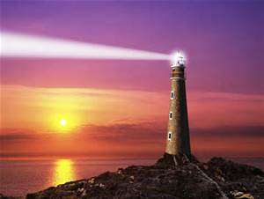
“Lighthouses don’t get all wobbly when the weather gets rough… they just stand there shining”.
~ Author unknown

