Slide 1
AMERICANISM
2014-2015
Ann King –Smith – Chairman
Committee Members:
Tina Hanson
Jerry Shermon

Slide 2

“Lighting the Way for Our Veterans”

Slide 3
AMERICANISM MISSION
PROMOTE PATRIOTISM and
RESPONSIBLE CITIZENSHIP

Slide 4
ABOUT…..
Providing Learning Opportunities

Slide 5
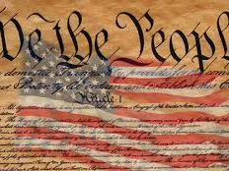
Our Constitution

Slide 6
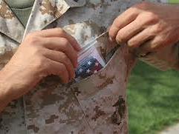
Folding Pocket Flags for Troops

Slide 7
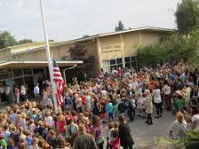
Presenting Flags to Local Schools

Slide 8
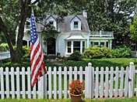
Flying the flag on patriotic holidays

Slide 9
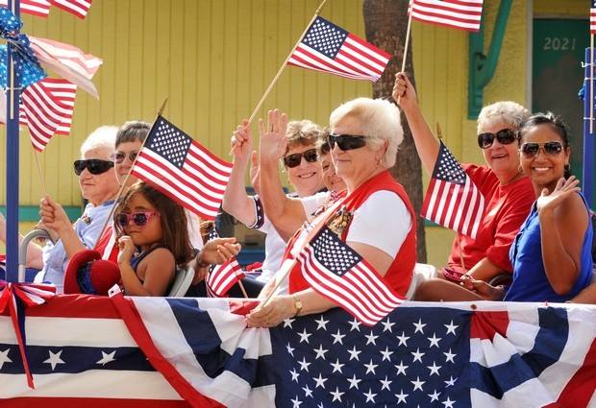
“Shine” on Patriotic Holidays

Slide 10

Contact Elected Officials for Support

Slide 11
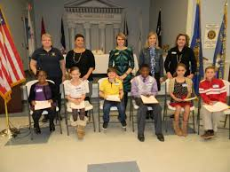
Americanism Essay Contest
What Does Freedom Mean to My Family
Grades 3-12
Grade levels divided into 5 classes
One award for each class per division

Slide 12
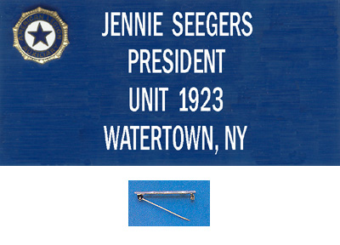
Always Wear Your Name Badge

Slide 13
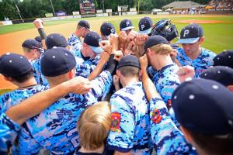
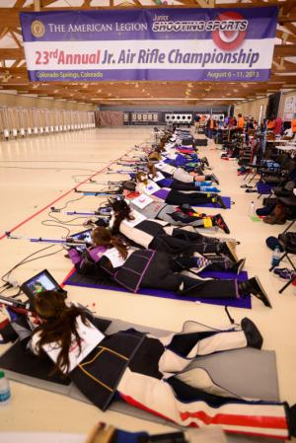
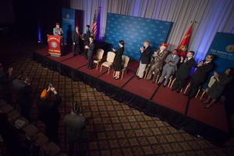
Support American Legion Programs

Slide 14


Slide 15
MID-YEAR REPORT
YEAR-END REPORT

Slide 16
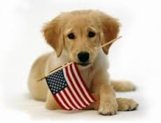
Promote the
Red, White and Blue in All That We Do

