Slide 1
AMERICANISM
2023-2024

Slide 2
Department Americanism Committee
Chairman
Tammy Zell
americanism@alafl.org
Committee Member
Jasmine Harris

Slide 3
PROMOTE
OVERWHELMING
PATRIOTISM
#POPAMERICANISM

Slide 4
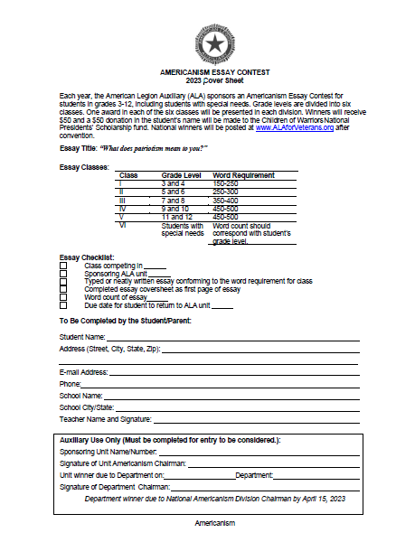
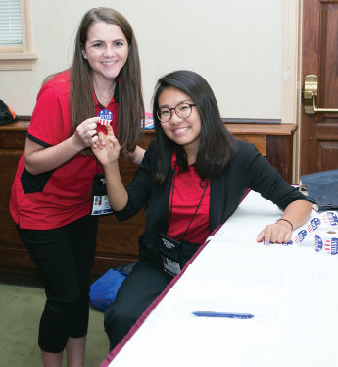
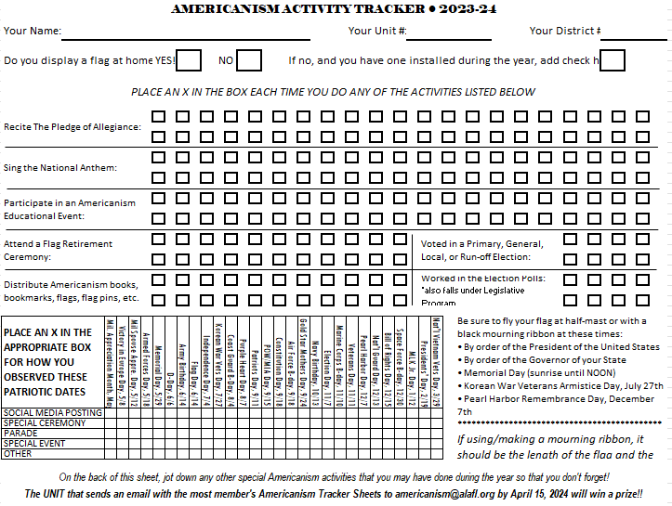

Slide 6
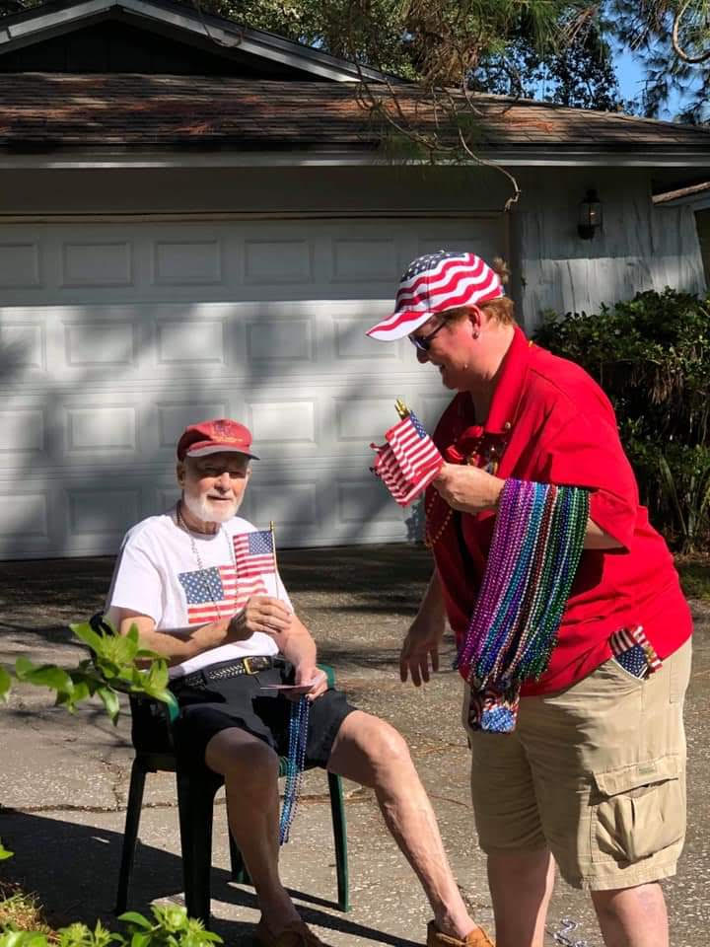
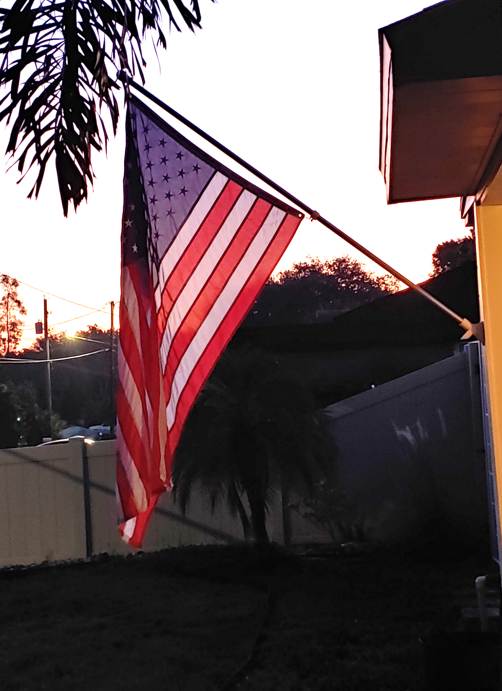
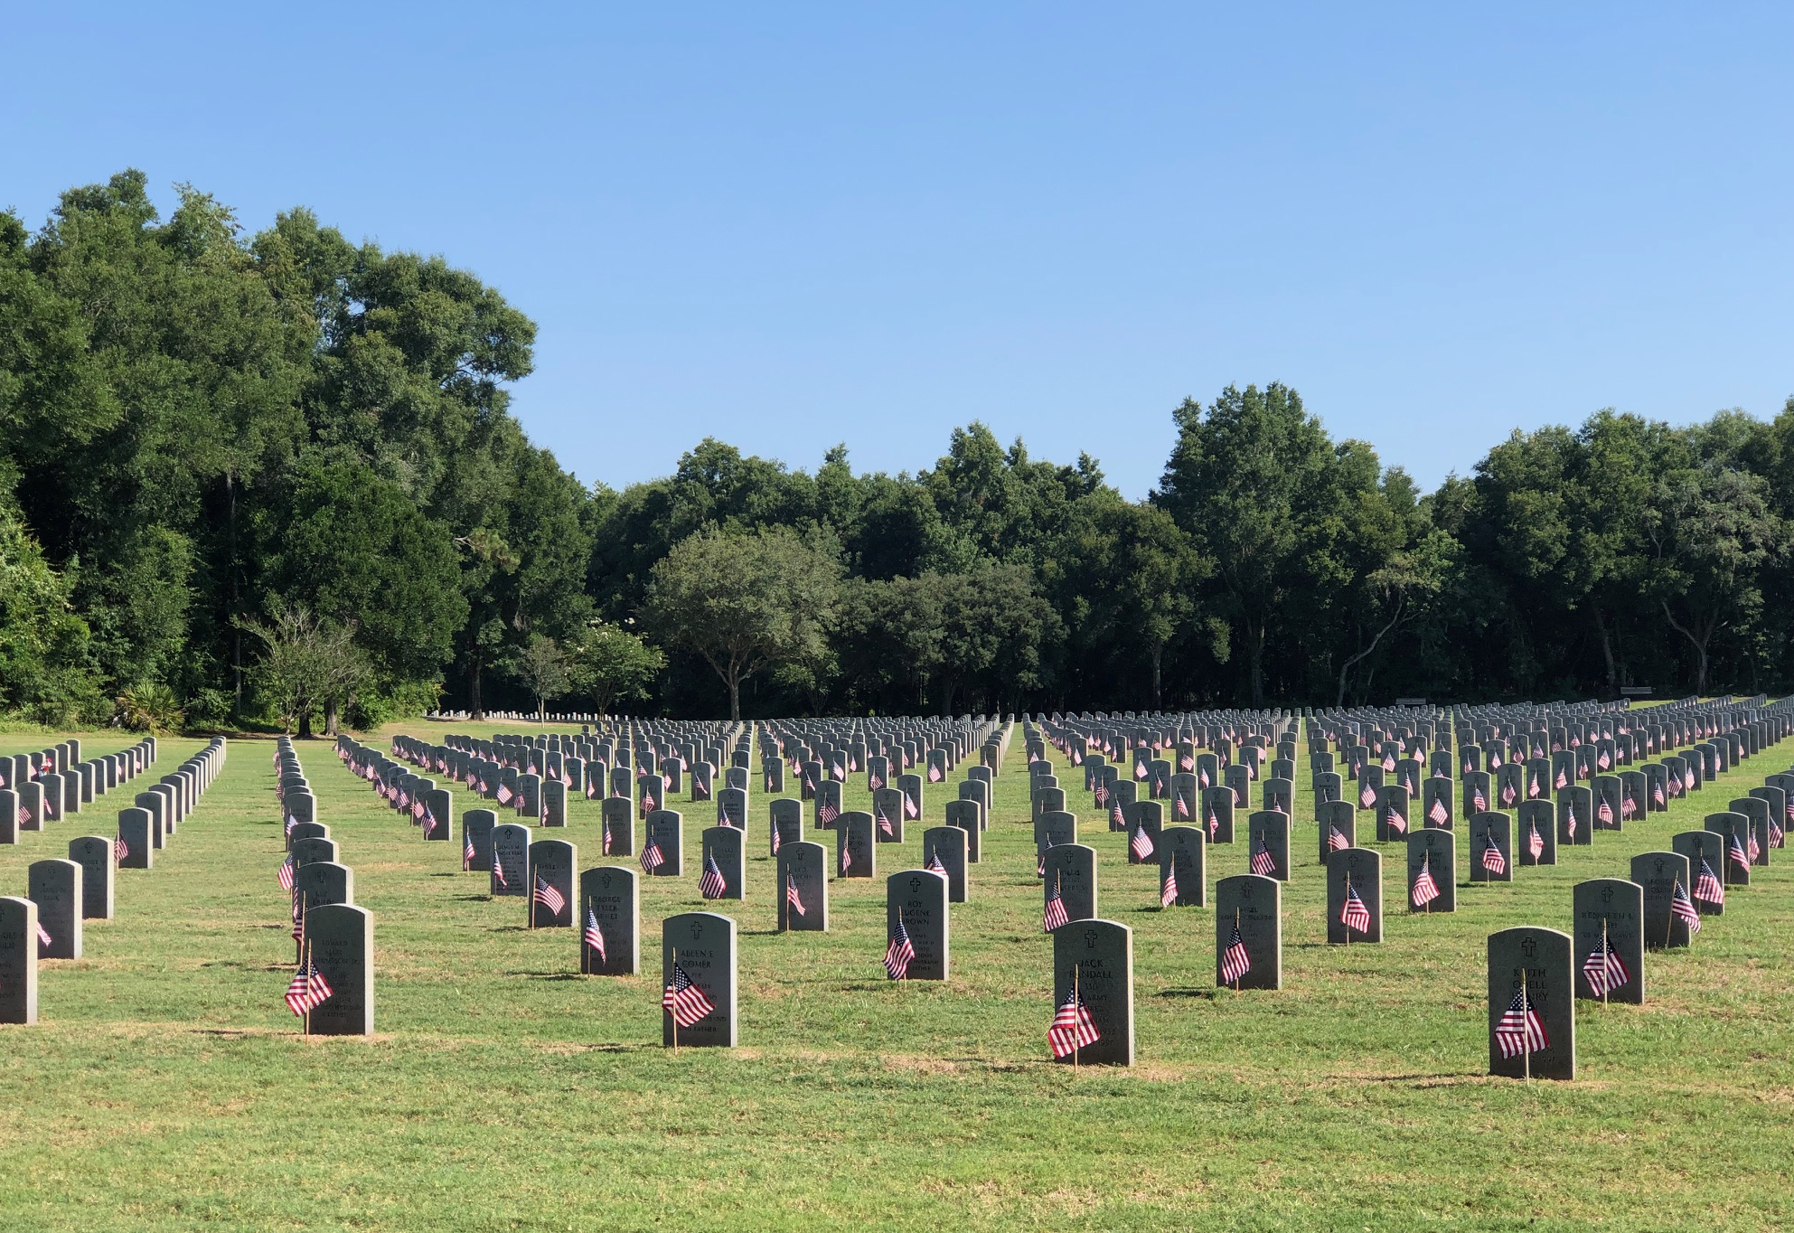
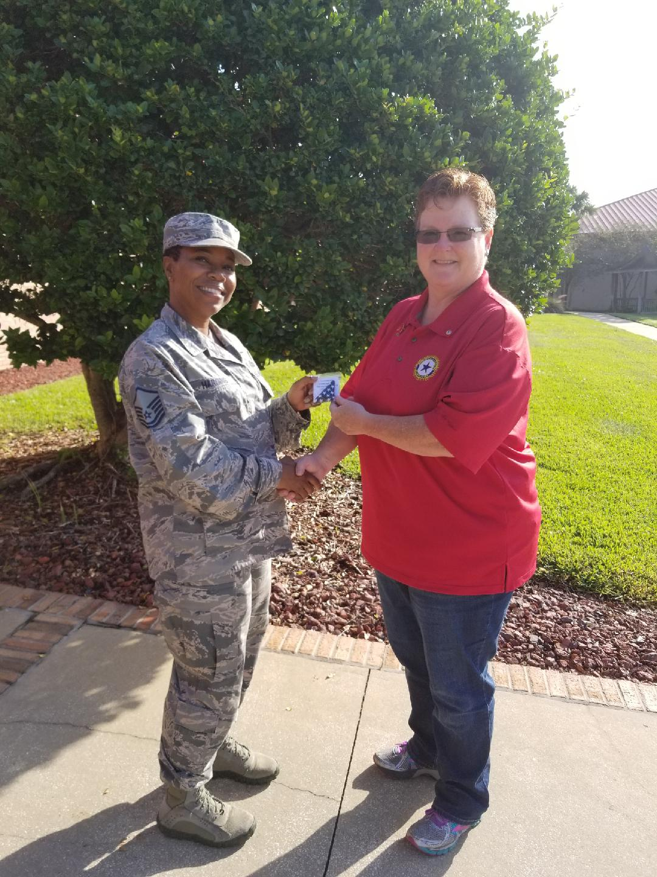
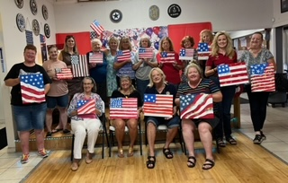
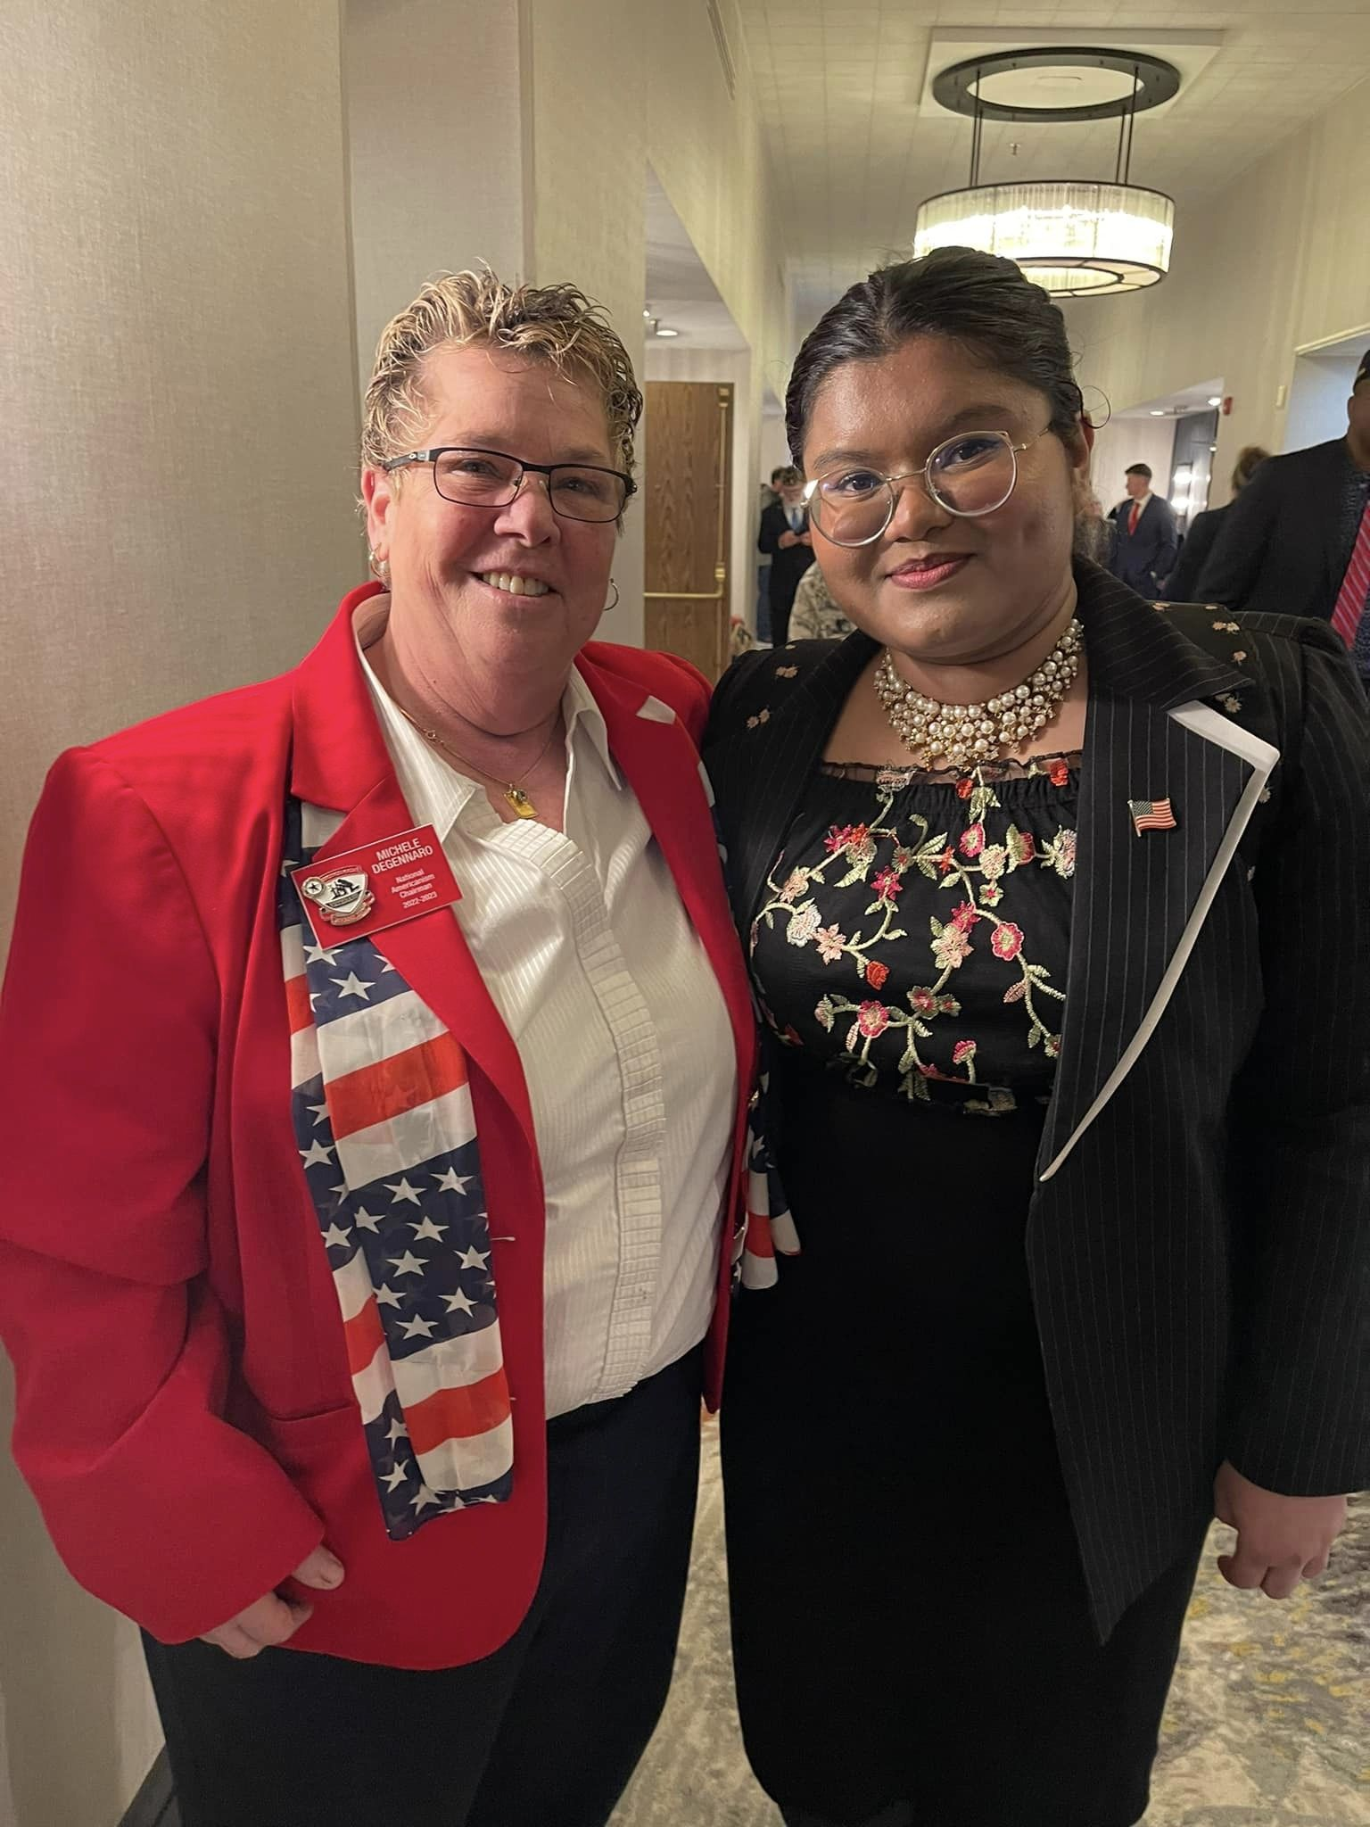
HOW DO WE MAKE THIS HAPPEN??

Slide 7
YOUR AMERICANISM ESSAY THEME IS…

Slide 8
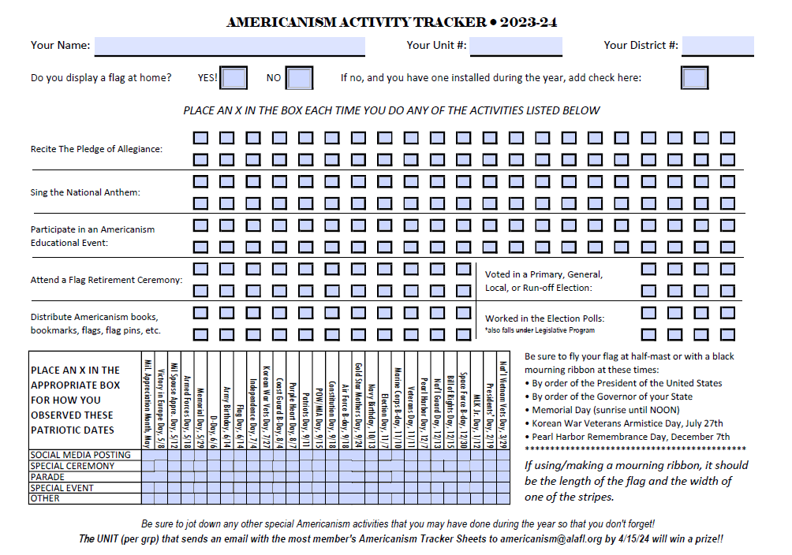
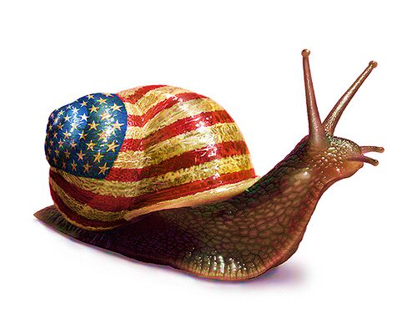
Tell Your Unit’s Story!
Trackers due to americanism@alafl.org by April 15th
Unit Reports • Due April 1st
District Reports • Due April 15th
All reports are to be submitted electronically - no more snail mail!!

Slide 9
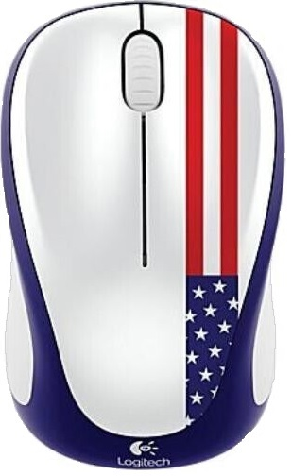
Info is just a click away!
Your Program Engagement Plan is
available on www.alafl.org/programs/americanism
ALA National: www.legion-aux.org
American Legion: www.legion.org
Flag Code and info graphics, Legion baseball, oratorical contest, and more!
Flag & Emblem Sales: www.emblem.legion.org
DVD, booklets, pamphlets on flag education

Slide 10
Let’s recognize
those that
P.O.P!
Post & Email Upcoming Events
americanism@alalfl.org
FaceBook: ALAFL Americanism
Start following us TODAY!

Slide 11
YOU’RE #1!!
National Awards
Americanism Essay Contest
“What does Freedom mean to me?”
Dorothy Pearl Plaque
Most Outstanding Americanism Program targeted to children and youth
Department Awards
Doris E. Hahn Trophy
Best All-Around Award for Americanism Activities
Chairman’s Award
The Unit that Promotes the best “Star Spangled Kids” program
Tracker Award
The Unit, by Grouping, to submit the most Tracker Sheets to americanism@alafl.org

Slide 13
QUESTIONS??
#ringyourbell
#alaflamericanism
#popamericanism

